Slide 1

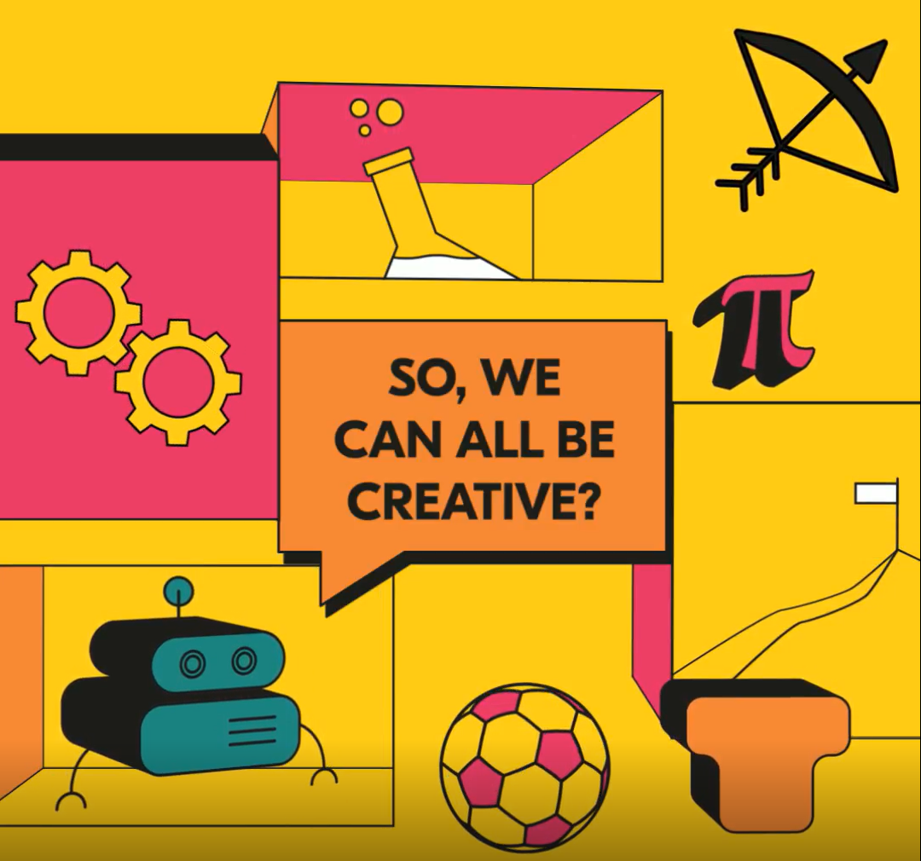
Playing with Creativity
Key questions:
What is creativity?
Why is being creative important?
What can we do to develop our creativity?
^{@A_New_Direction}
^{anewdirection.org.uk}

Slide 2
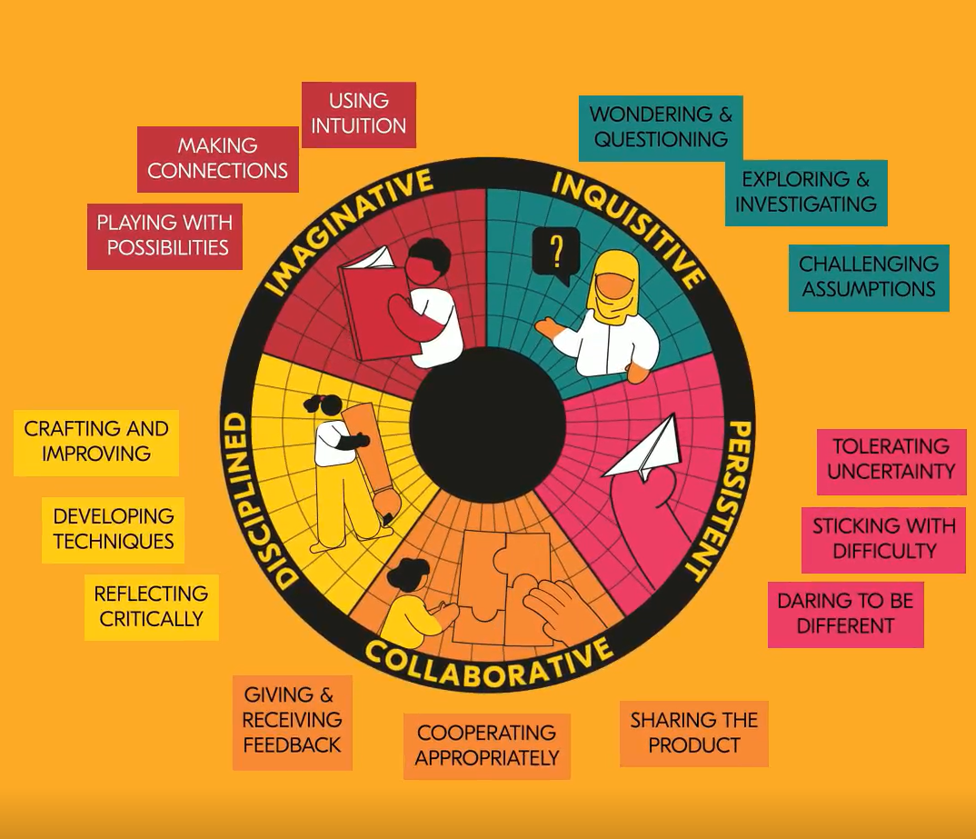
Playing with Creativity
Developing our creativity
^{@A_New_Direction}
^{anewdirection.org.uk}

Slide 3
Playing with Creativity
The importance of creativity
Pause for reflection:
Why do we need to develop our creativity?
When was the last time you were creative?
‘You can’t use up creativity. The more you use, the more you have.’
Maya Angelou
^{@A_New_Direction}
^{anewdirection.org.uk}

Slide 4
Playing with Creativity
Creativity helps us solve problems
Science and engineering:
The top engineering award, UK Young Engineer of the Year, supported by Thales, was awarded to Kanav Jain from Broxburn, Scotland, for AeroAid: autonomous VTOL quadplane.
Inspired by the difficulties of delivering emergency supplies to remote communities, Jain designed a low-cost autonomous aircraft capable of transporting medicines and other essential items where conventional transport links are limited.
https://labnews.co.uk/big-bang-winners-showcase-next-generation-of-stem-innovators/#
.
^{@A_New_Direction}
^{anewdirection.org.uk}
Notes:
Click the URL link to load the webpage for a picture of the Kanav and his plane

Slide 5
Playing with Creativity
We use creativity to express ourselves
Art and music:
Picasso talked about the challenge of staying imaginative as people got older. He thought all children were artists, but it was hard to keep this childlike imagination in adulthood.
https://www.tate.org.uk/kids/artists/who-pablo-picasso
^{@A_New_Direction}
^{anewdirection.org.uk}

Slide 6
Playing with Creativity
Pause for reflection:
How will you develop your creativity?
Which creative skill will you develop?
How will you develop it?
How will you use your creativity in your learning this term?
^{@A_New_Direction}
^{anewdirection.org.uk}

