Slide 1
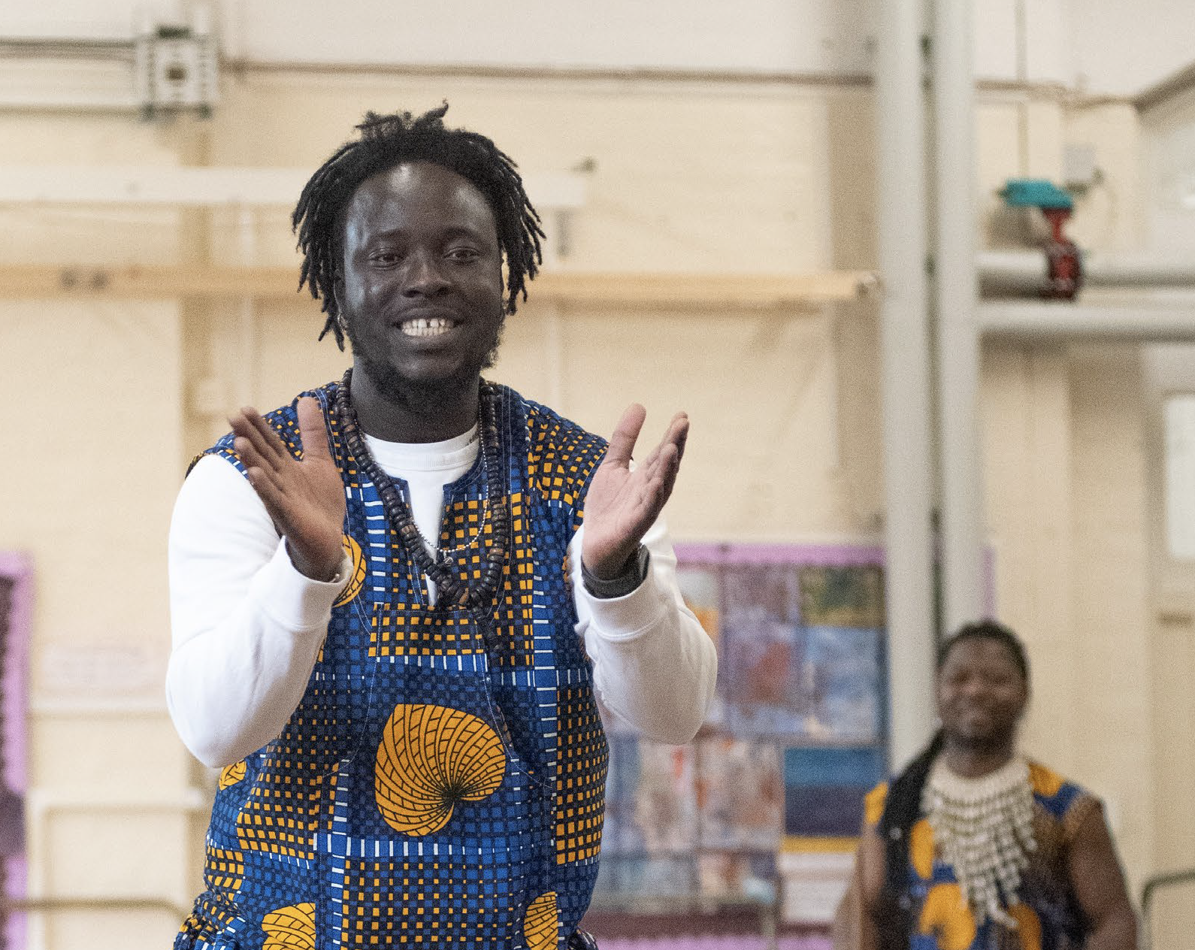

Mbilla Arts: Routes to Rhythm
This Showtime! pack contains:
Information you can share with teachers and parents ahead of the school visit
Pre-Show pupil activity
Post-Show pupil activities
Mbilla Arts promotes the music and dance forms of Africa and the diaspora through performance and education programmes. Our experienced artists provide extensive expertise in arts education and performance.
In-Schools Touring Schools’ Resources – Showtime! Pack

Slide 2
Information for teaching staff taking part in the workshop and show.
Before the workshop and show it would be helpful if you could:
Share what is happening and when with your colleagues in school. We have included a poster template on the next page that you could print out for the staff room to let people know what’s happening.
Let parents, carers and the wider school community know what is happening – we have provided some wording to help. Just add the details then copy and paste.
Prepare your pupils – there are some ideas on how to do this later in the resource pack.
We also have a separate visual story and information about our access and sensory kit to support with this.
Make sure you have the resources needed for the workshop.
Let any teaching/support staff who will be present during the workshop and show know what to expect so they can support pupils to access the experience.
Here is some more information about the organisation visiting your school which you could share with teachers:
Mbilla Arts promotes the music and dance forms of Africa and the diaspora through performance and education programmes. Led by master drummers from West Africa and accompanied by high-energy dancers, Mbilla Arts' performance explores the origins of West African music and dance styles, tracing its journey from the African Continent across the Atlantic to the Caribbean and influencing carnival celebrations in the UK today.

Slide 3
Showtime!
Pre-show information for the school. Stick me up on your staffroom wall!
What you need to know.
Our school is taking part in Primary Arts, a new creative cultural programme for London’s primary schools from A New Direction.
We have booked a touring session. Performers will be visiting us in school to provide a show and workshop for pupils and twilight CPD for staff.
Classes taking part:
Staff member organising it:
Date of show and workshops:
Staff members attending:
Who is visiting us?
Date & time of Teacher Twilight CPD
Where the show is taking place:
Timings of the show and workshops
Title of the show:
Routes to Rhythm

Slide 4
Information to share with parents, carers and the wider community before the show.
Below is some suggested copy for a letter home to parents/carers or inclusion in your school newsletter:
We are delighted to let you know that our school is taking part in Primary Arts – a new creative, cultural programme for London primary schools from A New Direction.
We have booked a touring session, and Mbilla Arts will be visiting us in school to provide an experience and workshop for pupils in [INSERT CLASS/ES TAKING PART] on [INSERT DAY AND DATE].
Mbilla Arts promotes the music and dance forms of Africa and the diaspora through performance and education programmes.
Their performance will be led by master drummers from West Africa and accompanied by dancers to explore West African music and dance styles from the African Continent across the Atlantic to the Caribbean and influencing carnival celebrations in the UK today.
The supporting workshop includes an opportunity to learn to play the djembe drum, and step-by-step teaching of African People's Dance accompanied by live drumming. At the end, there is an opportunity for solo performances within the group in an atmosphere of carnival celebration with drumming and Soca music.

Slide 5
Pre-Show
Showtime!
What you need to know
Mbilla Arts promotes the music and dance forms of Africa and the diaspora through performance and education programmes. Our experienced artists provide extensive expertise in arts education and performance.

Slide 6
Preparing pupils for the show.
Before the workshop and show you can let your pupils know what to expect using some of the key info and discussion questions below.
Mbilla Arts are coming to visit us to do a workshop and a show!
A group of master drummers and dancers will help us explore the origins of West African music and dance styles.
They will also teach us about the djembe drum and African People's dance. We will be able to ask questions and take part in a carnival celebration with drumming and Soca music.
Pre-show discussion questions
You might like to talk through the following prompts to be ready for the performance.
What is a show and what makes it special?
What makes a good performance?
What makes a good audience? E.g.
  Stay sitting down so everyone can see and hear.
  Respect everyone’s personal space.
  Don’t talk when the show is on unless the musicians and dancers ask you to take part.
You can also let your pupils know what to expect using the discussion prompts on the next page.
Depending on your pupils, for example pupils with SEND/younger children, you might want to share extra information about what sensory or interactive elements might happen or you might choose to leave that as a surprise. We have also provided a separate visual guide and information about our access and sensory toolkit.

Slide 7
Thinking about our show and workshop
What do we need to remember when we have visitors to school?
How do you feel about the show coming to our school? Are you excited, nervous, happy?
How can we make sure that we all enjoy the show? For example, we will need to sit and listen very carefully.
What props do you think you might see in the show?
In some parts of the show, they might ask us to take part – what do you think they might ask us to do?
What kind of music, songs or sounds do you think the show will include?
How will we know when to stop taking part and it is time to sit and listen again?
What do we do at the end of the show to say thank you?

Slide 8
Additional resources for your school!
Prior to your school's performance and workshops taking place, your school will also receive:
A box of books containing a range of fiction and non-fiction titles for all year groups, linked to the themes explored by the shows in this year's programme. These are for you to use in book corners or the school library.
A themed booklist showing the books you've been sent and a range of additional titles you might find interesting.
A box of creative art supplies and a themed resource with ideas for creative activities. This box contains a wide range of items that we hope will bring creativity to life in your classroom in many different ways!
The box of creative materials is for your school to use how you like! We suggest that it be used for the class/es that took part in the Primary Arts In-Schools Touring workshop and show for some extra creative activities. Most of the items in the box can be used for more than one project, as we wanted to ensure that it included lots of core art materials that, if looked after kindly, will be used again and again.
Each box contains the following materials:
Glue Sticks
PVA Glue
White Card (A6)
Black Card (A3)
Coloured Card (A4 & A3)
White Sugar Paper (A3)
Coloured Sugar Paper (A4)
Coloured Tissue Paper
Paper Plates
Lolly Sticks
Masking Tape
Double-Sided Tape
Plain Matchboxes
Stripy Pipe Cleaners
Oil Pastels
Modelling String
Split Pins
Clay (Mixed Colours)
Air-Drying Clay (Terracotta)
Coloured Cellophane
Stick-on Wiggly Eyes
Felt Tips

Slide 9
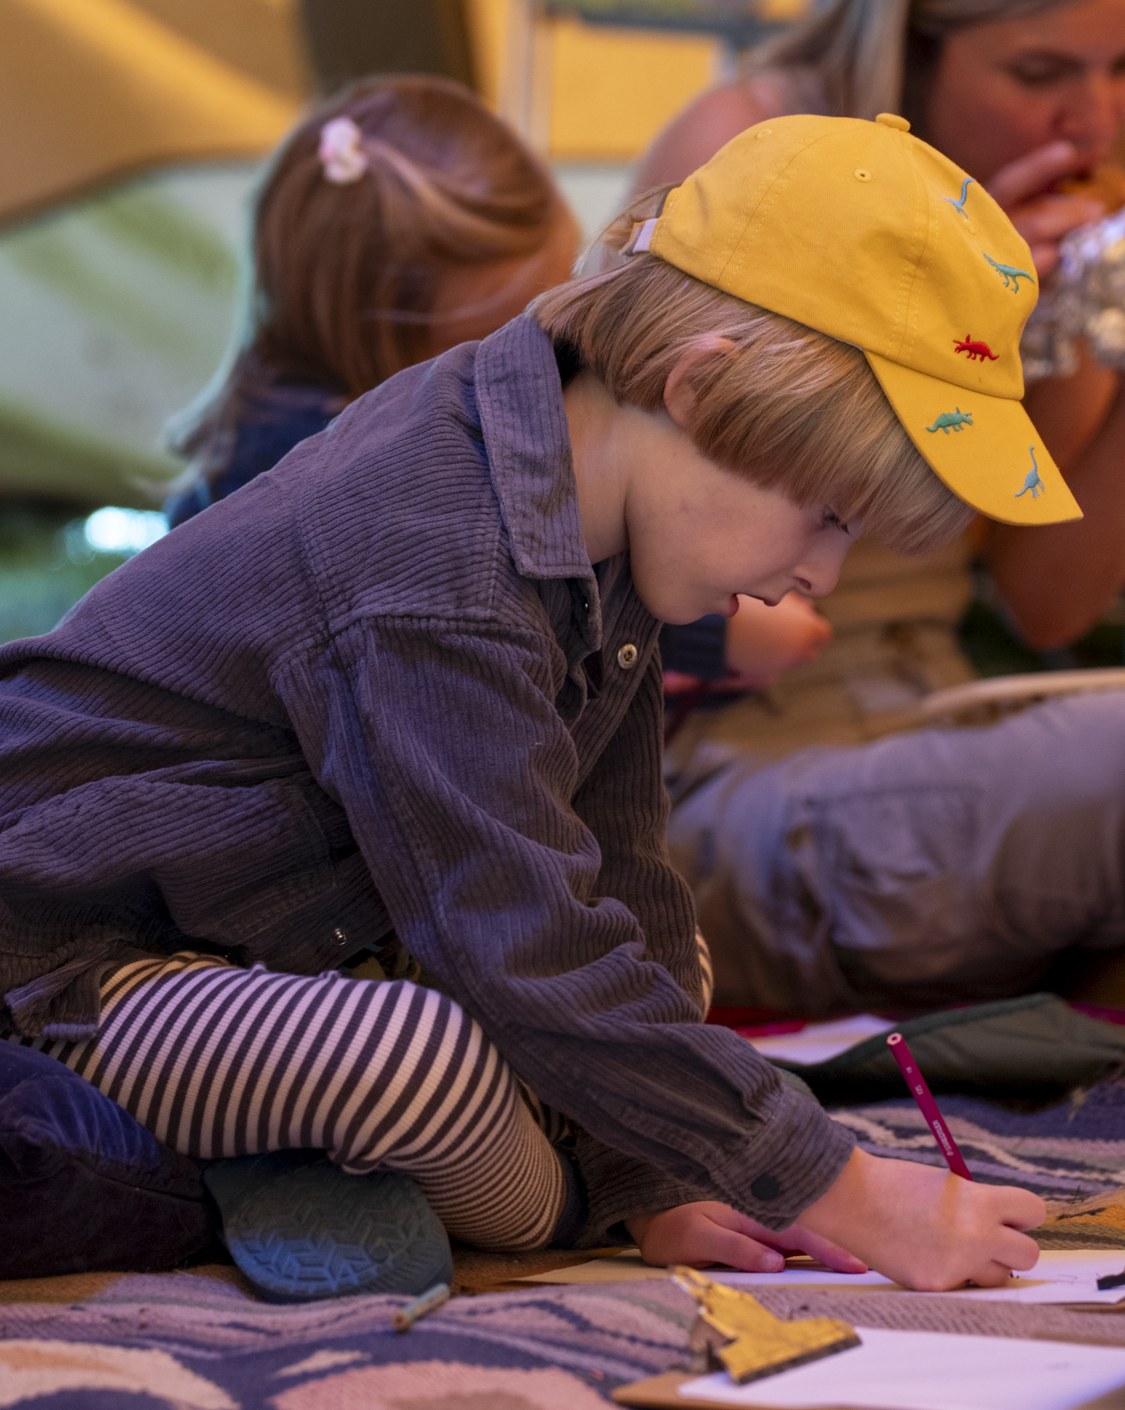

Take a bow!
Post-Show Activities
We hope that your school enjoyed the workshops and show!
Exploring the themes of the show and supporting pupils to reflect on the experience, we have suggestions for 10 minutes, 30 minutes or a full 1-hour lesson.

Slide 10

If you have 1 hour or more
Activity provided by
Mbilla Arts
Dance the Story: Exploring West African Dance
Step 1: Warm Up (5 mins)
Lead a simple movement warm-up with claps, stomps, and stretches to a steady beat. Encourage students to listen and move together.
Step 2: Explore West African movement (10 mins)
As a class, discuss daily activities in West African life (e.g. farming, fishing, washing clothes, carrying objects, celebrating). Try out simple movements inspired by these actions. (See example photos on the page below, which can also be downloaded from our website.)
Step 3: Group Creation (25 mins)
In small groups, students choose 3–4 movements and arrange them into a short “dance story” that shows a community activity or celebration. They can repeat or vary movements to create rhythm.
Overview
Create and perform short dance sequences inspired by West African rhythms and daily life.
Materials Needed:
Open classroom space or hall
Optional: drum track or steady beat (handclap or percussion app)
Mbilla Arts African Drumming Resource Pack (provided at CPD) – includes links to examples of West African music and dance.
Paper & pencils (for planning)

Slide 11
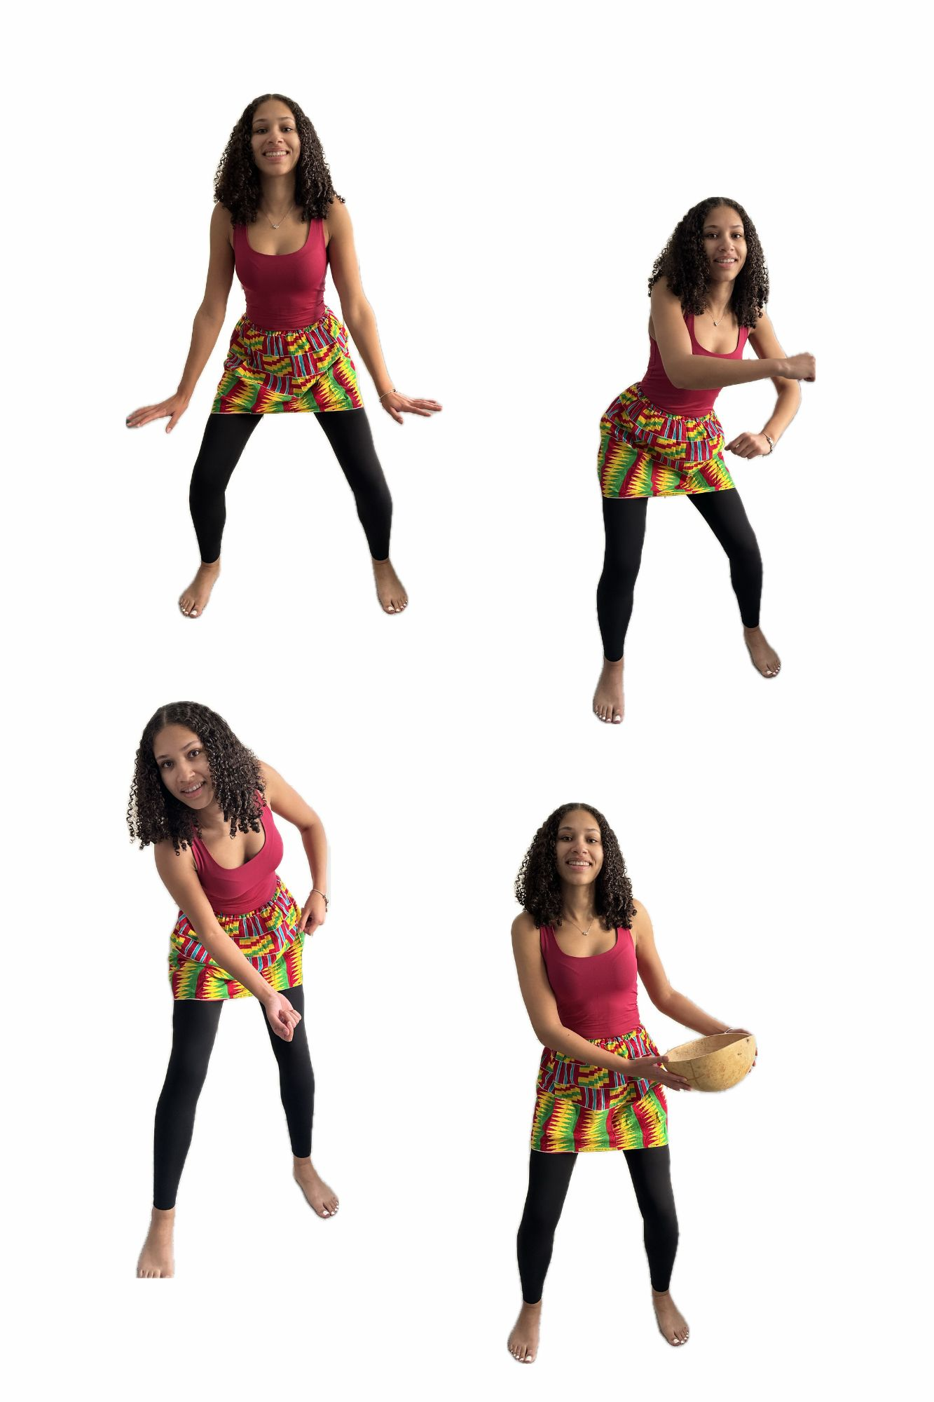
If you have 1 hour or more
Activity provided by
Mbilla Arts
Dance the Story: Exploring West African Dance
Step 4: Add Rhythm (5 mins)
Students choose how to keep time – clapping, drumming on desks, or using feet. Pupils practise staying in time as a group.
Step 5: Perform and Share (10 mins)
Each group performs their short dance story to the class. Encourage positive feedback focusing on rhythm, teamwork, and storytelling.
Step 6: Cool Down (5 mins)
Gentle stretching and deep breathing to calm the body.
Image credit: Mbilla Arts CIC

Slide 12
Teacher notes
Activity provided by
Mbilla Arts
This resource is aimed at KS1 and KS2
For EYFS / SEND / Older Pupils
Reflection Questions
For younger or SEND students, simplify to two movements and model together. Use images or props to support understanding.
Older students can add spoken word, call-and-response, or percussion layers.
How did your group show rhythm and teamwork in your dance?
What story or feeling did your movements express?
How did it feel to move to the beat together?
Go Further
Creative Skills
Students could record their dance and add percussion or narration using simple instruments or digital tools.
In this activity, children are being collaborative by cooperating appropriately & being imaginative by making connections.

Slide 13

Thank you!
We hope that your school enjoyed the show!
Please share your experiences with other teachers in your network and encourage schools to sign up for information about next year’s Primary Arts programme at: www.anewdirection.org.uk/primary-arts

