Slide 1
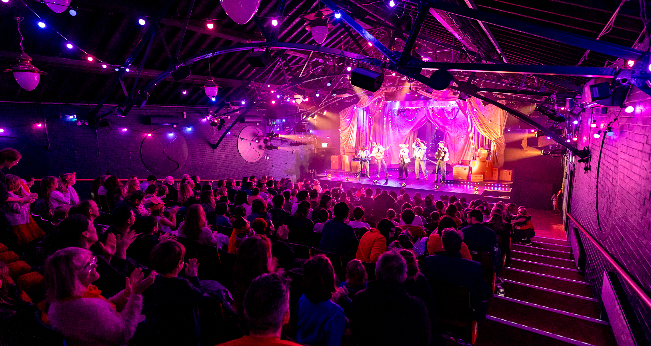
Showtime!
Go & See: Theatre
An opportunity to explore a new environment, engage with world-class theatre, and develop new knowledge and skills.
This pack contains:
A set of resources to use before the show to help you share information with your colleagues, parents/carers and pupils so everyone knows what to expect.
A set of classroom activity ideas to use with your pupils after your show.
Go & See: Schools’ Resources

Slide 2

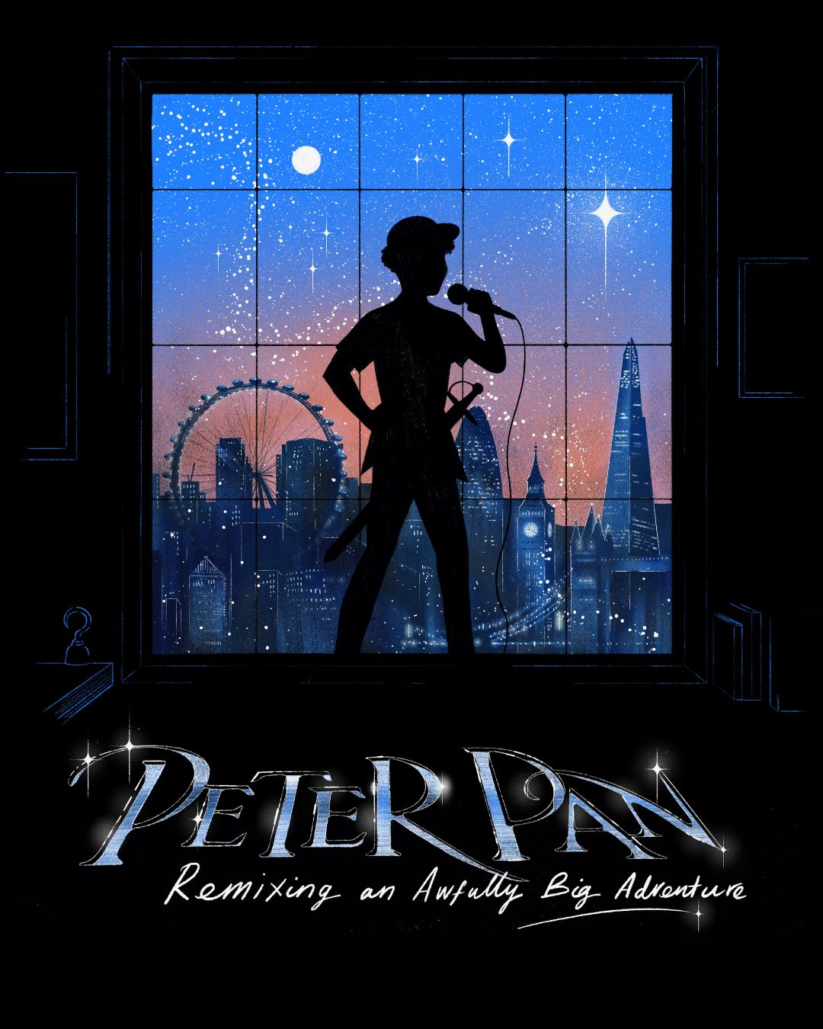
Teacher Notes
Information to share with teaching or support staff before the show.
Before the theatre trip:
Share what is happening and when with your colleagues in school – you could print out and stick up the next page of this resource on your staffroom wall.
Let parents, carers and the wider school community know what is happening – we have provided some wording on the following pages to help. Just add the details then copy and paste.
Prepare your pupils – there are some ideas on how to do this later in the resource pack. We also have a separate Visual Guide resource to support with this.
Let any teaching/support staff who will be present during the trip know what to expect so they can support pupils to access the experience.

Slide 3
Showtime!
Theatre Trip: What you need to know
Our school is taking part in Primary Arts Go & See, a new creative, cultural programme for London primary schools with A New Direction.
We have booked a theatre visit.
Which classes are taking part?
Staff member organising it.
Date and time of the show.
Other members of staff going.
The show we are going to see is:
Where the show is taking place.
Any other useful information:
Duration of the show.

Slide 4
Information to share with parents, carers
and the wider community before the show.
Below is some suggested copy for a letter home to parents/carers or inclusion in your school newsletter:
We are delighted to let you know that our school is taking part in Primary Arts Go & See – a new creative, cultural programme for London primary schools from A New Direction.
The Go & See programme aims to increase access to high quality, inspiring arts, cultural and creative opportunities for students and staff in London’s primary schools.
We have booked a trip to [INSERT VENUE] in [INSERT LOCATION] as an experience for pupils in [INSERT CLASS/ES TAKING PART] on [INSERT DAY AND DATE].
[Choose the relevant paragraph for the show you are going to see on this page or the page that follows.
Lyric Hammersmith: Cinderella
As the clock strikes midnight, join our fearless dreamer and their magical companions on a whirlwind journey; a festive spectacle for the whole family from West London. Following 2016’s ‘wickedly good’ Aladdin, writer Joel Horwood and director Robin Belfield return to sprinkle their signature Lyric magic over this timeless tale. Expect midnight mischief, show stopping tunes, laughter and an unmistakable Lyric twist that transforms a classic story into an unforgettable adventure.
Polka Theatre: Peter Pan
Join Peter and Wendy on an awfully big adventure in a quest to never grow up. Joined by the mischievous Lost Boys and feisty fairy Tink, can they work together to defeat the formidable Captain Hook, who’s determined to take Peter’s sword and rule over Neverland once and for all?
From the creative minds behind ‘Pied Piper’ and Polka’s ‘Romeo & Juliet’, comes a magical family musical adventure, packed with original songs performed live by a company of award-winning vocalists, beatboxers, and rappers.
Find your courage, choose your happy thought, and learn what it means to grow up – or not!

Slide 5
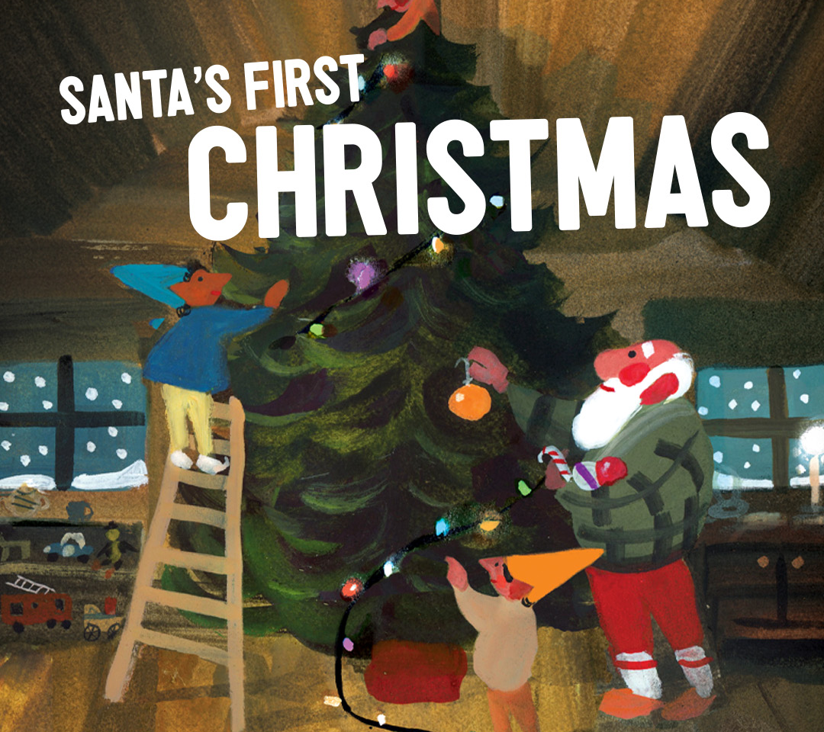
Theatre Royal Stratford Robin Hood and the Merry Mandem
Stratford is buzzing. The lights are glowing. And deep in the heart of E15, a new kind of hero is taking off their blazer and putting on a hoodie.
Join the Merry Mandem as they zip across East London streets, stations, shops and estates. They roll through Maryland, dodge the Central line rush and keep a close eye on anyone trying to ship them off to that terrible place far, far, away at the other end of the line — a true villains’ punishment.
Robin and the crew are taking from the rich, backing the poor, and showing Stratford what happens when everyday people stand together. Expect an East End spectacle to remember, with stunning sets and costumes and rip-roaring comedy, Robin Hood will have you merrily riding off into the night.
The Postal Museum: The Jolly Postman Show Day
A jolly day of first-class fun at The Postal Museum. Step inside a much-loved story in an interactive show to help The Jolly Postman deliver the post for fairytale characters.
Journey underground on the Mail Rail Ride, get dressed for the job and move the mail in Sorted! The Postal Play Space and explore The Jolly Postman – 40th anniversary exhibition.
Unicorn Theatre: Santa’s First Christmas
Santa spends every Christmas Eve spreading joy around the world. He’s so busy making magic that he never gets the chance to celebrate himself – but this year his loyal, big-hearted elves are on a mission to give him the best Christmas ever.
With a huge tree, lots of tasty treats and plenty of festive cheer, Santa joins in the fun and discovers the true magic of Christmas, for the very first time!
Inspiration from the book written by Mac Barnett, illustrated by Sydney Smith. Published by Viking Books for Young Readers. This lively, engaging performance is the perfect joyful, festive treat for pupils to wrap up the year.

Slide 6
Information to share with pupils before the show.
Before the show, play each class the trailer of the production you are going to see (where available). You will find links to the trailers, as well as access information and extra resources on A New Direction’s website.
You might like to talk through the following prompts to be ready for the performance.
What is a theatre and what makes it special?
What makes a good performance?
What makes a good audience?
Following this discussion, you might want to make your own list of ‘being a good audience’ before checking it against some of these:
Be safe:
• Listen to and follow instructions from the theatre staff.
• Use the toilet before you go in to watch the show.
• Don’t eat while the show is happening
• Tell your teacher or other trusted adult if you need a break.
Respect other people:
Stay sitting down so everyone can see and hear.
Respect everyone’s personal space – don’t kick someone’s chair, wriggle or put your feet on the seats.
Don’t talk when the show is on unless the actors ask you to take part.
Say thank you:
• At the theatre we show our thanks by clapping. It’s important to clap the performers and also the crew, musicians, and everyone who helped make the performance possible.
• We also say thank you to the theatre staff for their help and assistance.
You can also let your pupils know what to expect using the discussion prompts on the next page.

Slide 7
Thinking about our theatre trip
Who do you think the main characters in the show will be?
How do you think you should behave when you are at the theatre?
What props do you think you might see on stage?
How can we make sure that we all enjoy the show? For example, we will need to sit quietly in our seat.
What kind of music, songs or sounds do you think the show will include?
In parts of the show, they might ask us to take part – what do you think they might ask us to do?
How do you feel about going to the theatre? Are you excited, nervous, happy?
What do we do at the end of the show to say thank you?

Slide 8
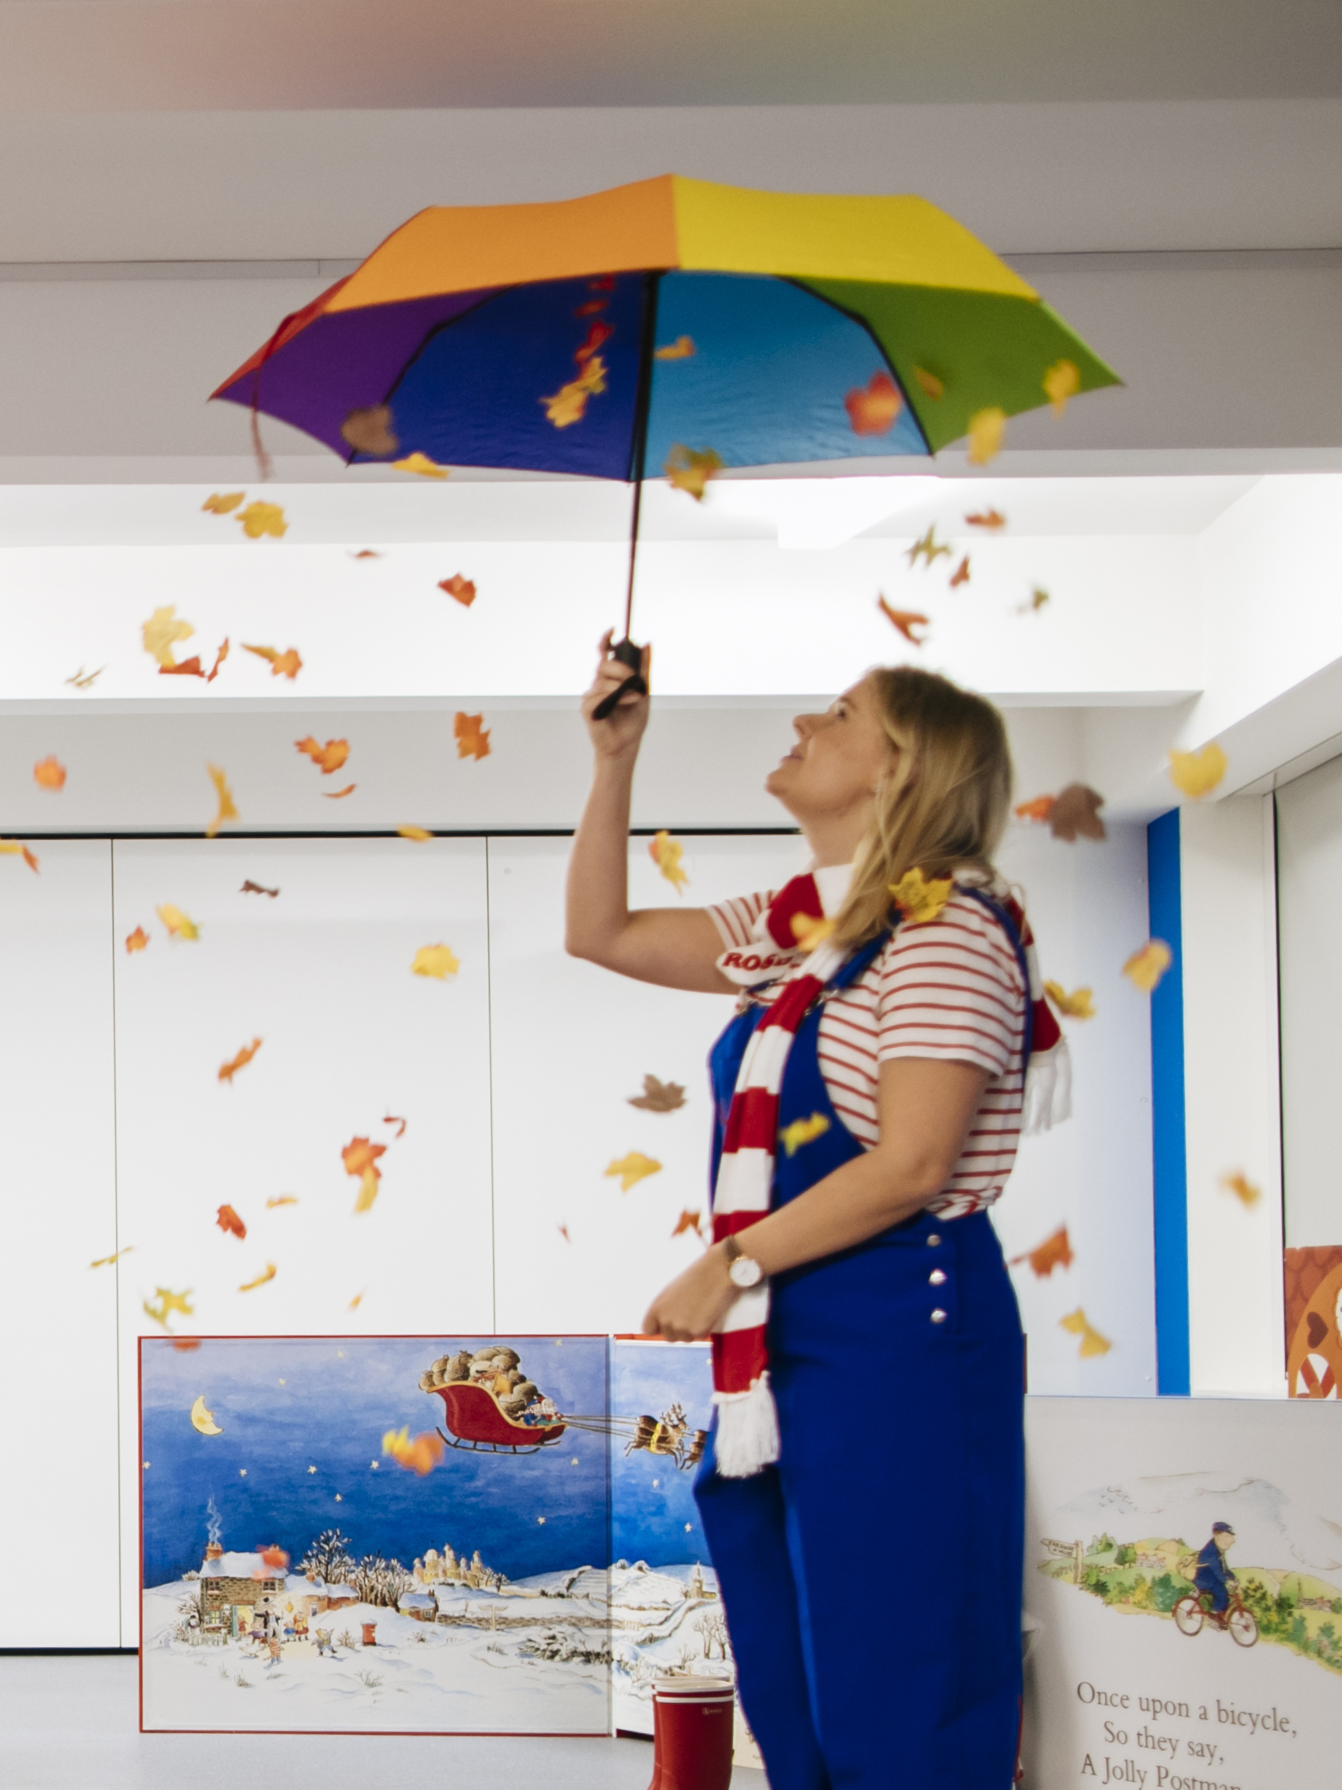

Take a bow!
Post-Show Resources
We hope that your school enjoyed the show!
Exploring the themes of the show and supporting pupils to reflect on the experience, we have suggestions for 10 minutes, 30 minutes or a full 1-hour lesson.

Slide 9
If you have 10 minutes
Box Office Vox Pop
Ask pupils to interview each other in pairs for a couple of minutes each, then as a whole class write up some short sentences to share in your school newsletter or assembly.
You have just come out of the theatre and a journalist grabs your attention to ask you what you think as you are leaving. Journalists: use a pen/ruler/your hand as a microphone and ask your talk partner:
• How are you feeling?
• What was the show you just saw?
• What was your favourite part?
• Can you sum up the performance in just one word?
Challenge students to think of their own questions and follow up questions to what’s been said.
Go Further: Pupils could write up a review of the experience or perform a memorable part in groups.
SEND: Focus on two of the questions and provide sentence frames, word mats with key vocabulary and pictures from the show to scaffold students as needed.
Creative Skills: In this activity pupils are collaborating by co-operating together and sharing reflections.

Slide 10
If you have 30 minutes
Invite others to see the show!
Do the discussion activity above to reflect on the show, then support pupils to think of something you could send or share with other pupils who haven’t yet experienced the performance.
Children at other schools are going to see the same show we saw. Let’s send them an invitation… how could we make them excited to see the show? What do we want to tell them and how can we do this in a creative way? What should we keep as a surprise? Why?
Allow pupils to think of ideas in groups and then present back to the class – they could perform, write up or draw their ideas.
Reflection: How does your invitation link to the show? What else does it make you think of?
Go Further: Pupils could make the actual invitations in DT/Art/Literacy lessons and then display them in the classroom/school hall/display boards.
SEND: Focus on thinking of an object and a word to send to other pupils that links to the show. Provide options and key words for pupils to choose from.
Creative skills: In this activity pupils are collaborating and being imaginative by playing with possibilities.

Slide 11
If you have 1 hour
Bring the play to life with a performance of 'talking tableaux'
​Ask your class to summarise the story (or 'plot') of the play in pairs – each person has one minute to try and summarise it. If anyone is feeling confident, see if they can tell the story in one minute to the whole class. ​
Show your class the 'plot' of the play, breaking it down into around 8 bullet points (depending on the size of your class). Did they remember them all? Which moment was the most exciting? Which moment was their favourite and why? Choose some questions to discuss or write in your exercise book. ​
In groups, bring the play to life as 'talking tableaux' (or talking pictures). Give each group one moment from the play to create as a still image that they will bring to life for one full minute. Before rehearsing their talking image, they should discuss who was in that moment, what was on stage, and the other details of what should happen in their scene. You may wish to list the characters on the board to support them.​
Each group presents their scene in order, bringing the story to life for one minute each. ​
Go Further: 'Freeze' the scene during performance to ask characters how they feel at key moments.​
SEND: Focus on one key moment which they can draw before acting out. Provide a print-out of the plot summary for their book.​
Creative Skills: In this activity pupils are collaborating by co-operating together and being.

