Slide 1
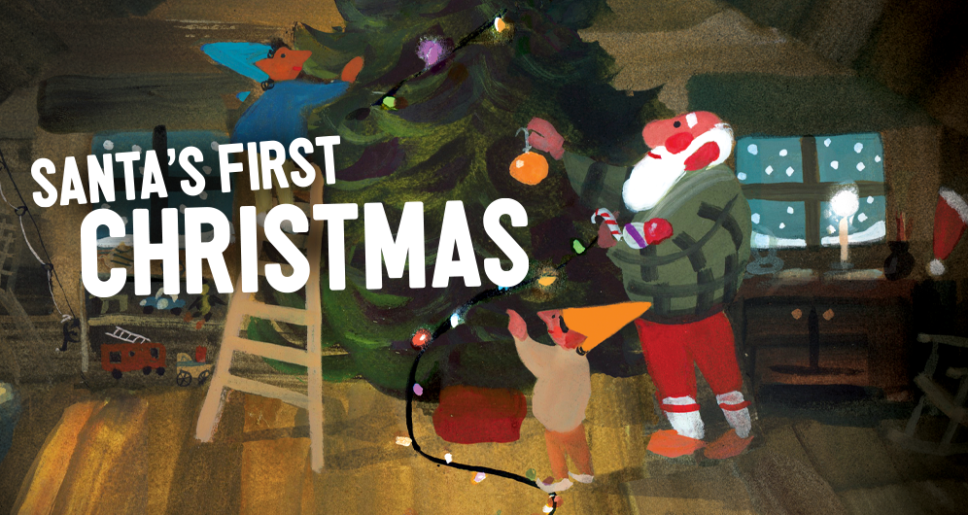

Go & See – Theatre
Visual Guide Resource
A visual guide to support pupils’ understanding of going to see a theatre show at The Unicorn Theatre in Southwark.
You can access additional resources on A New Direction’s website.
This visual guide could be particularly relevant to pupils who benefit from Social Stories. Teachers could read it with their classes before the trip and it could be shared as a handout for grownups to read at home too.
To find out more about Social Stories, please visit this website.
Go & See: Schools’ Resources

Slide 2
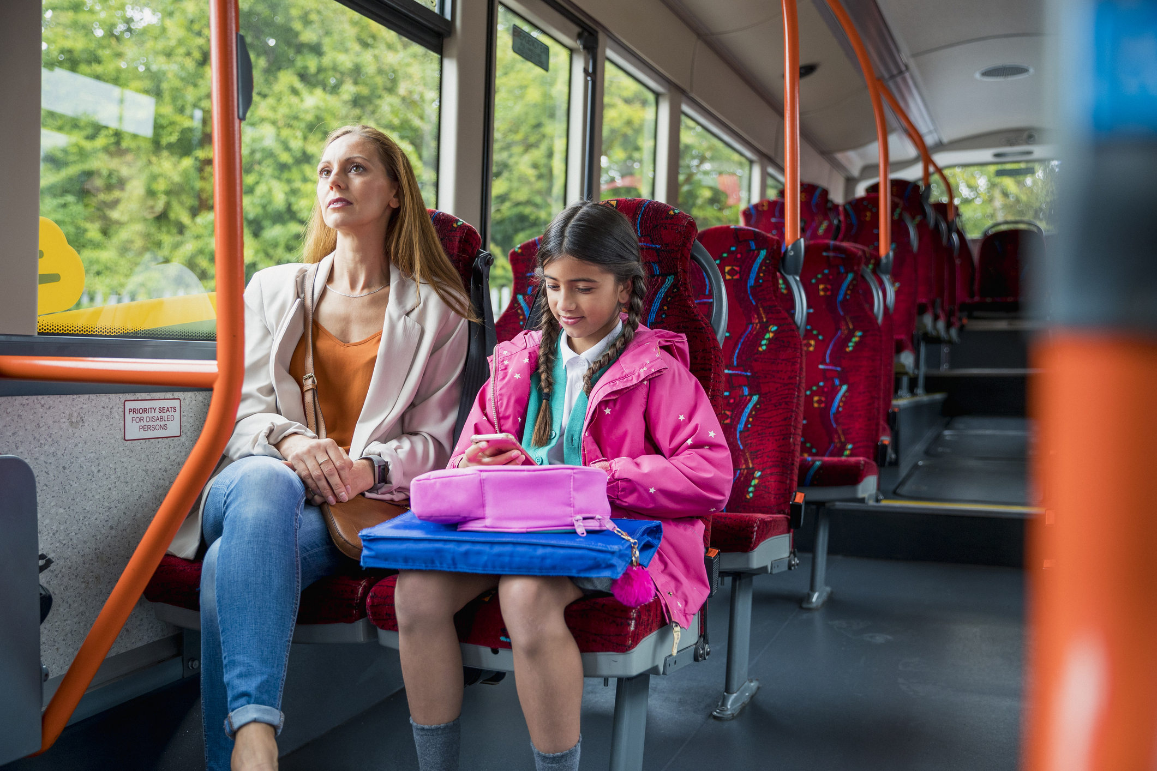
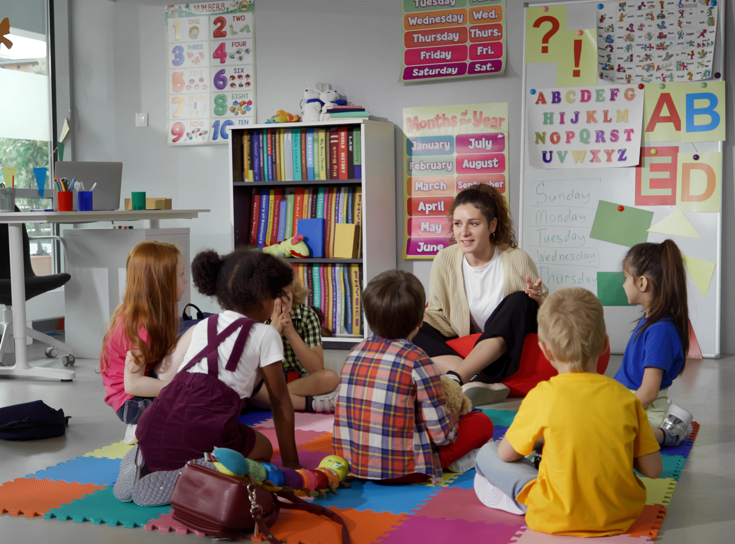
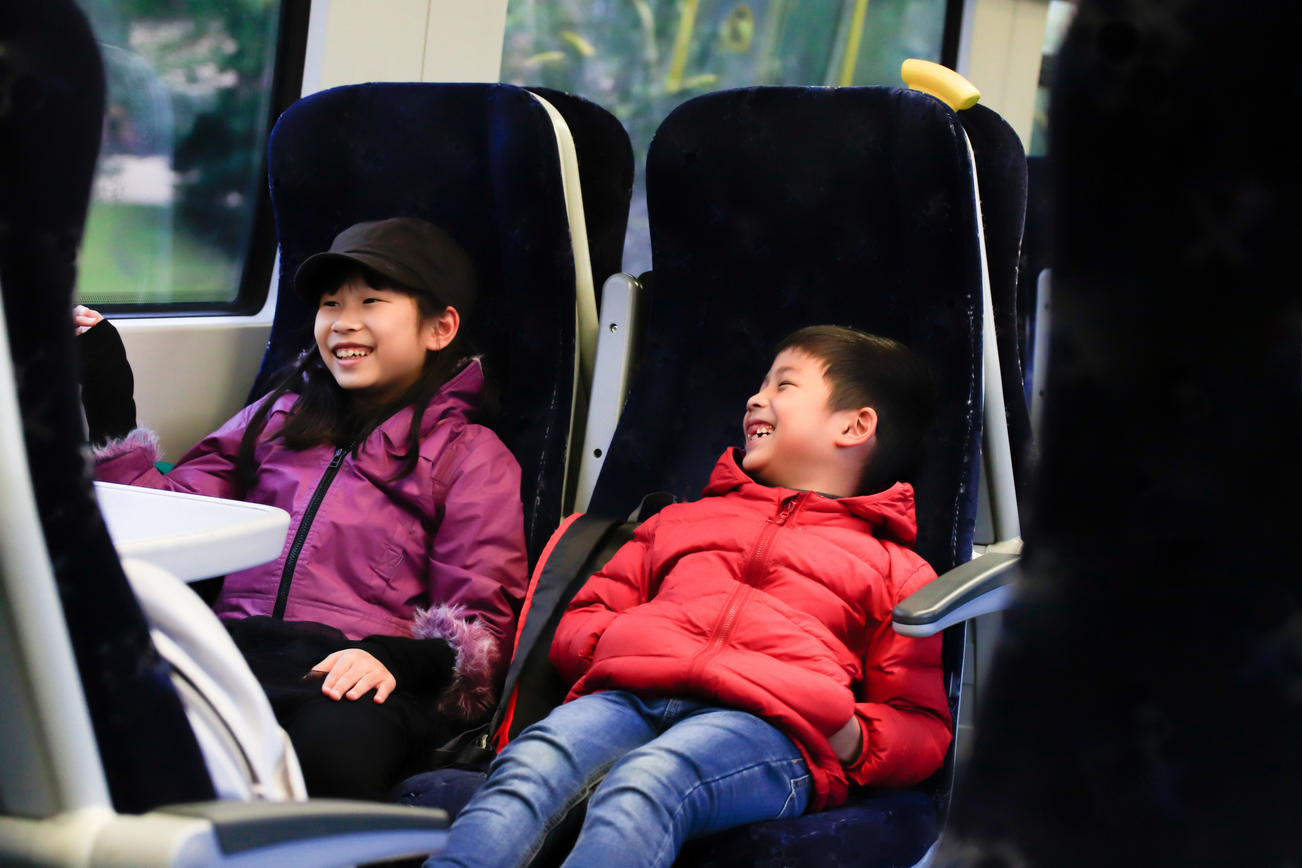

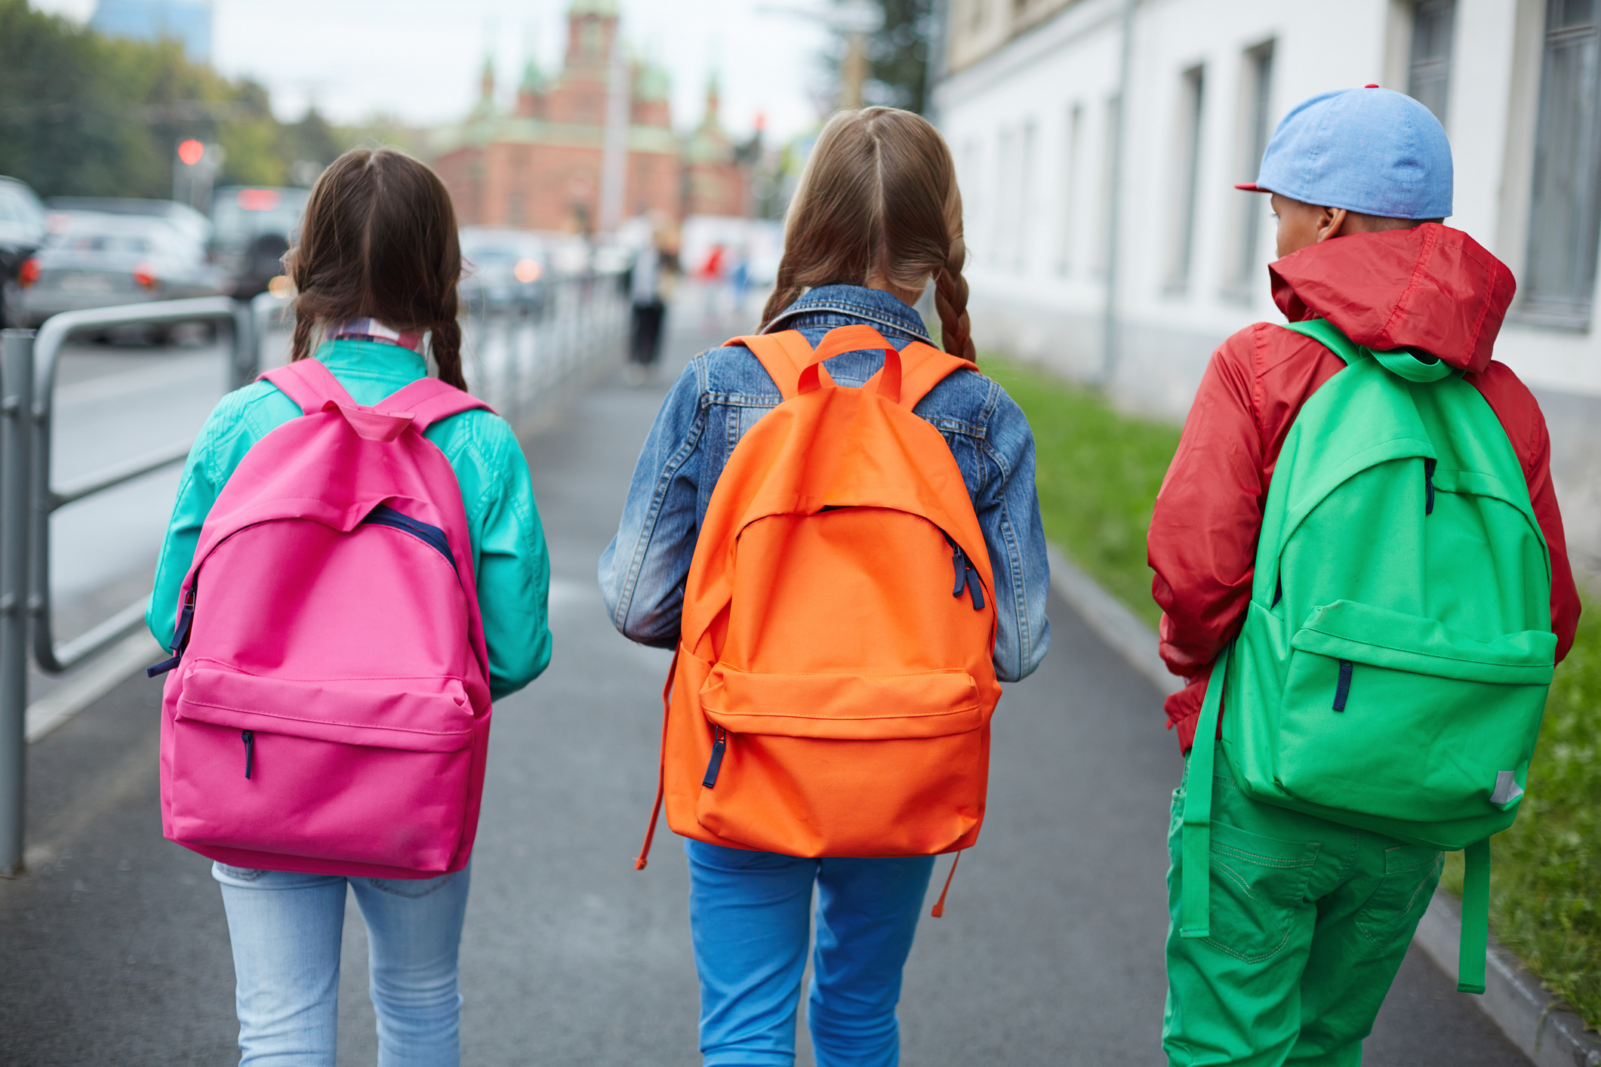
We’re going to the theatre!
I will travel to the Unicorn Theatre.
I might be travelling by bus,
or by train,
or on foot.
My class will be going there too.
My teachers will going be there too.

Slide 3
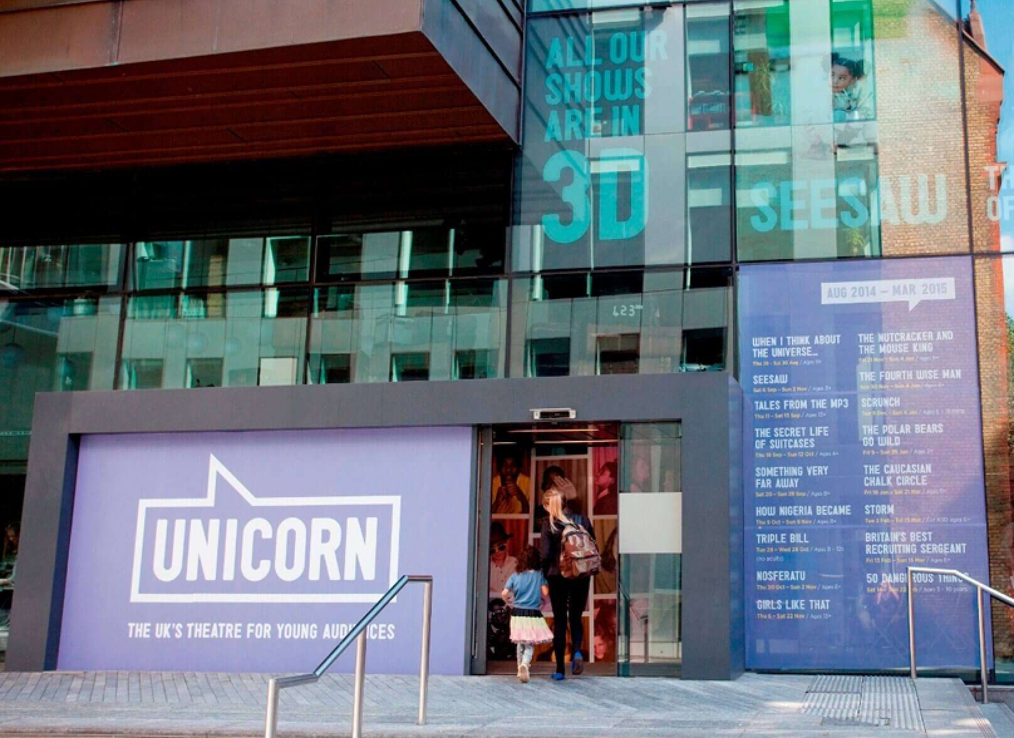
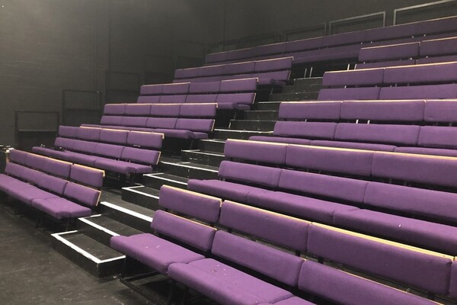
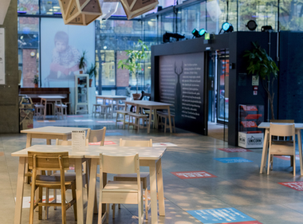
The Location
This is the outside of the theatre.
This is the inside of the building.
This is where I will watch the show.

Slide 4
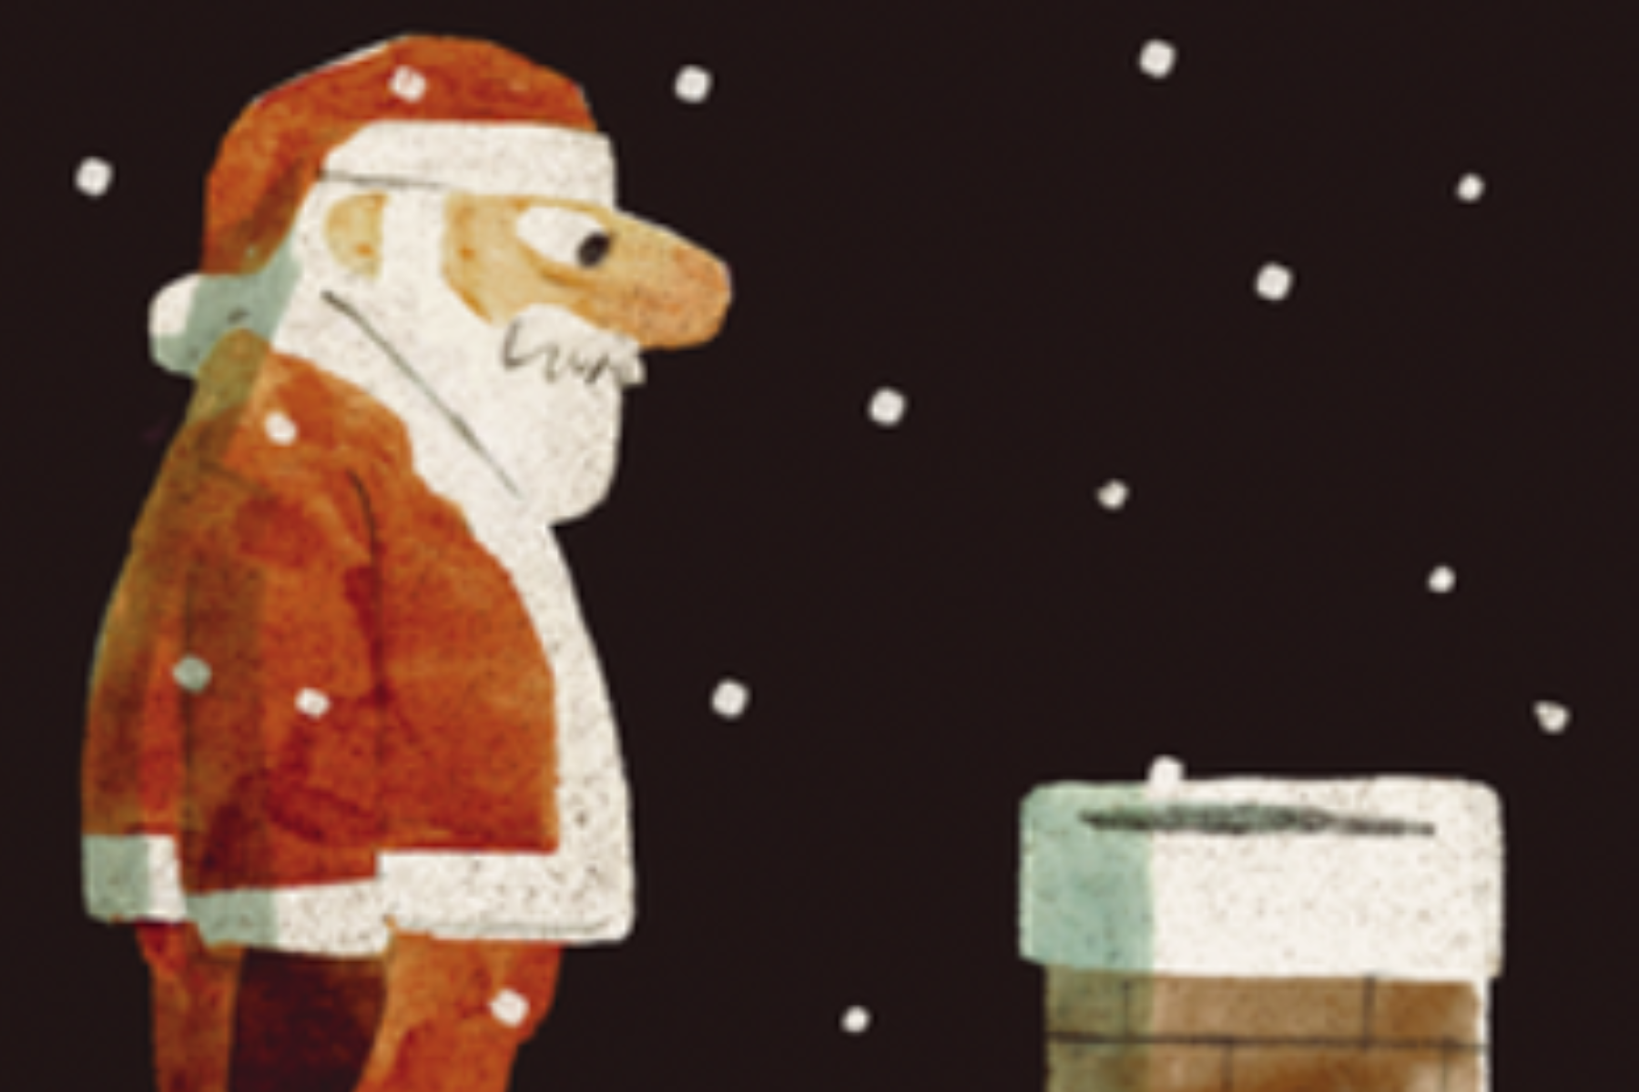
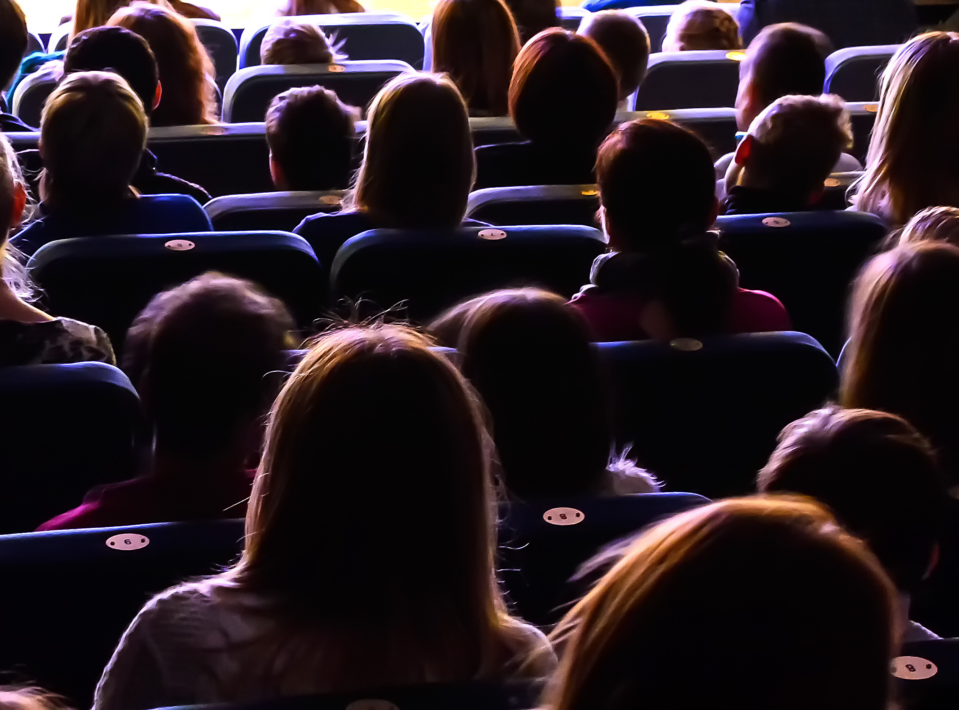
The Theatre
The venue staff will show me where to go and how to get to my seat.
The lights will be on to help me find my seat.
Once the show starts, it will go dark.
I will see the show It is 2 hours long.
It has a break in the middle called an interval.
Here is some more information about the show:
Santa spends every Christmas Eve spreading joy around the world. He’s so busy making magic that he never gets the chance to celebrate himself – but this year his loyal, big-hearted elves are on a mission to give him the best Christmas ever.
With a huge tree, lots of tasty treats and plenty of festive cheer, Santa joins in the fun and discovers the true magic of Christmas, for the very first time!

Slide 5
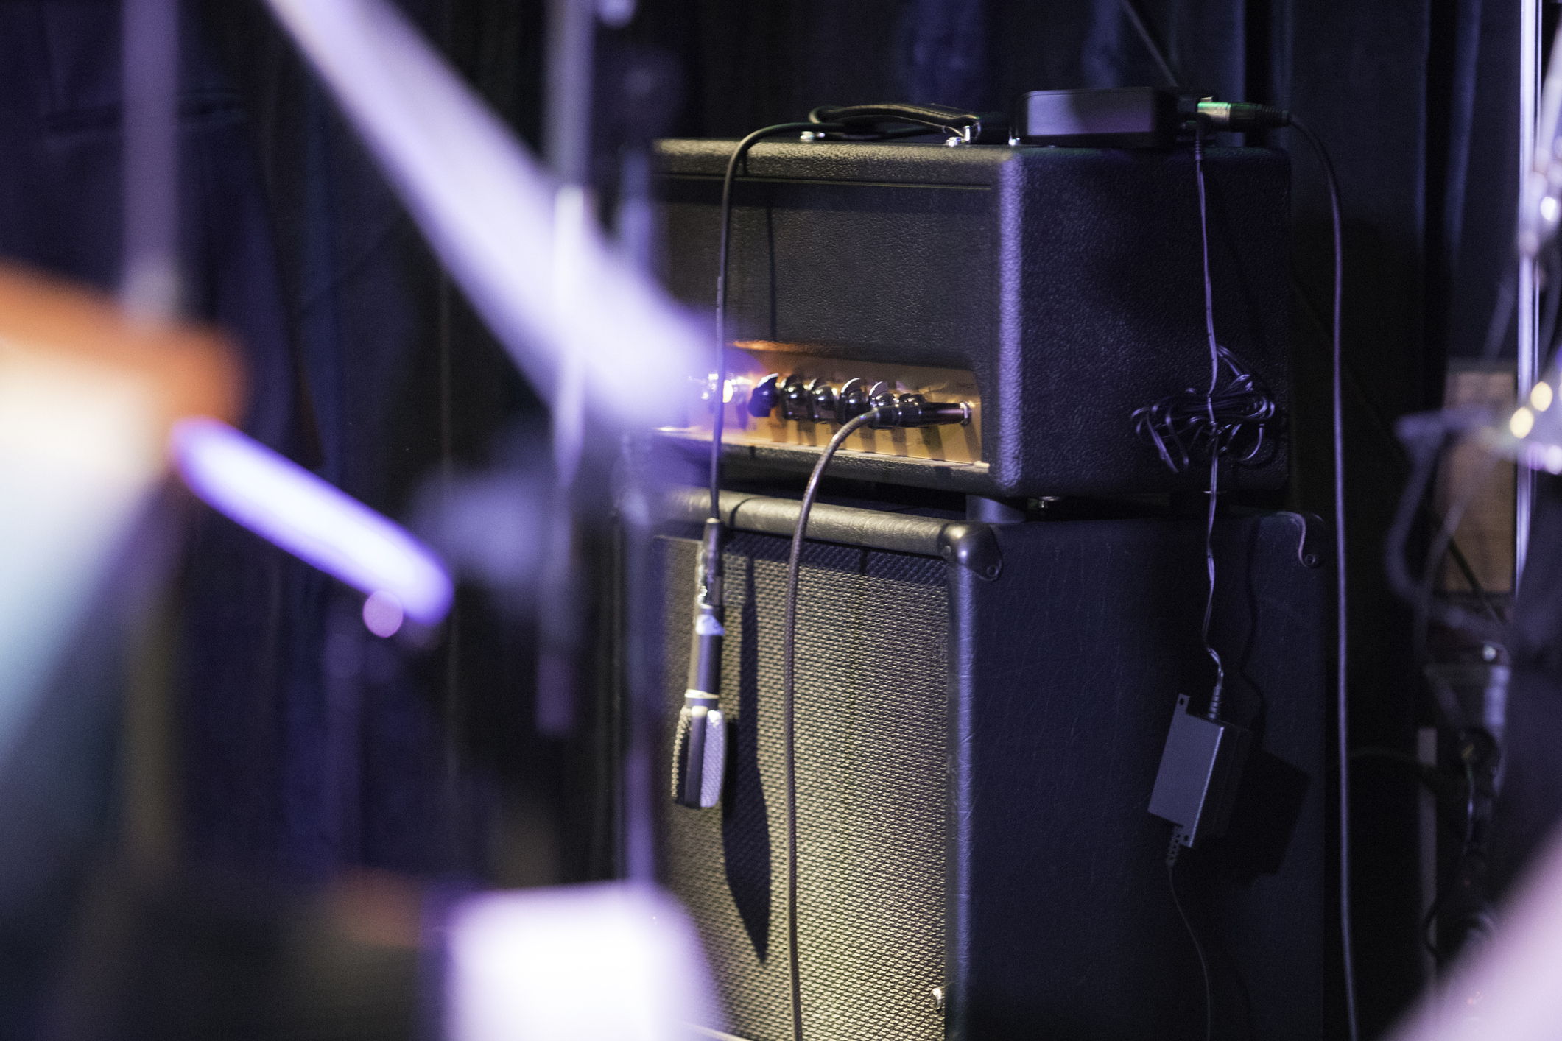
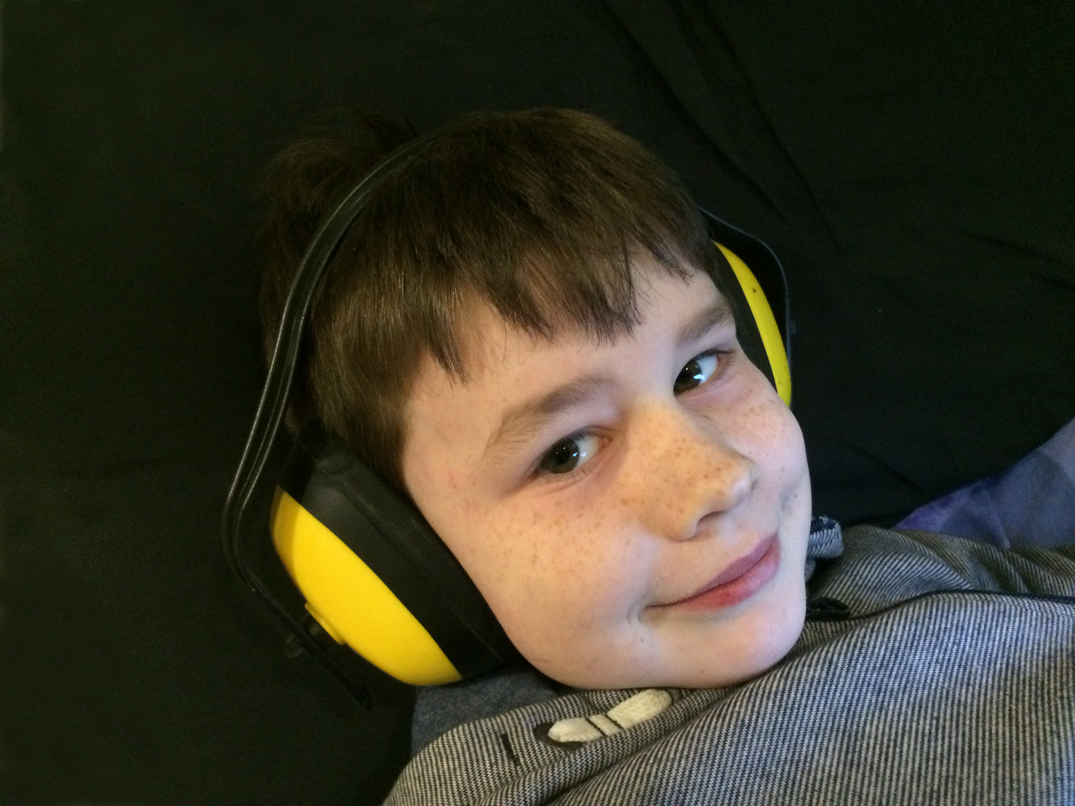
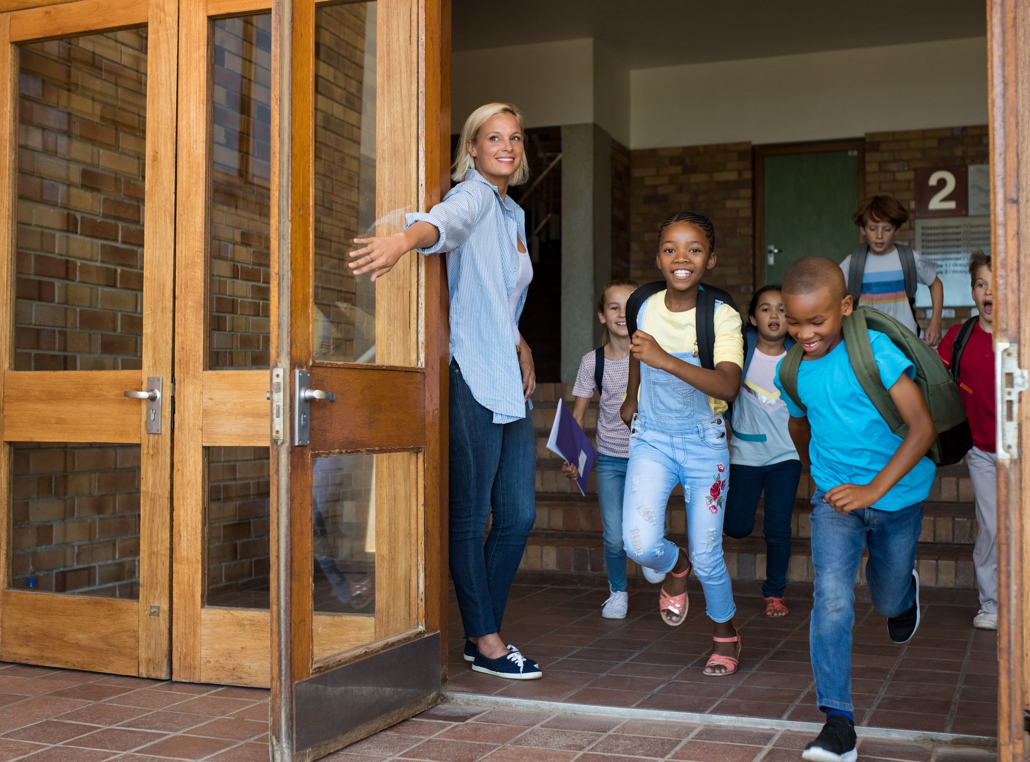
The Show
The show will have sounds and music.
If it is too loud, I can cover my ears or use ear defenders.
My class will be there.
Other schools might be there too.

Slide 6

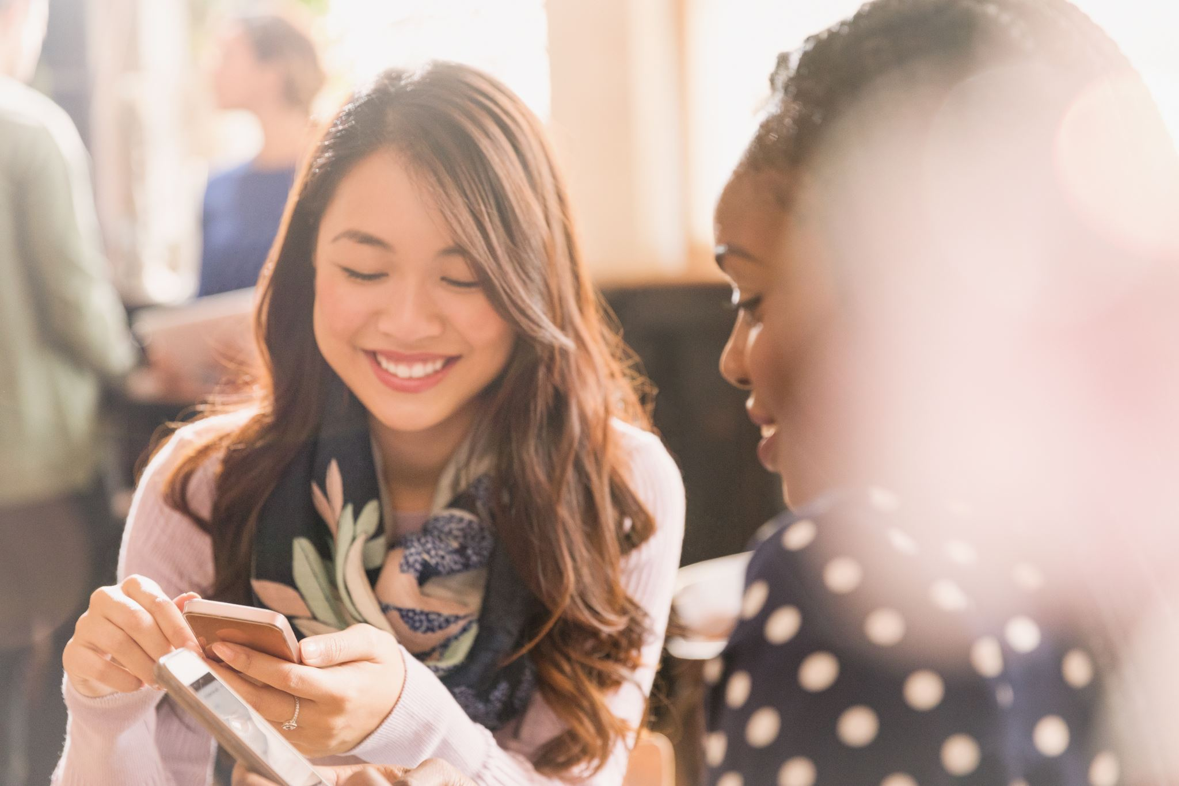
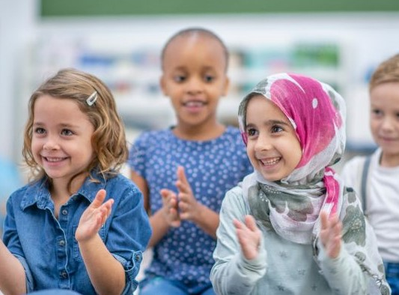
The Interval
There will be a short break in the middle of the show. This is called an interval.
The lights will come back on. The audience might clap.
People in the audience might talk and move around the theatre space.
When the interval ends and the show starts, it will go dark again.

Slide 7
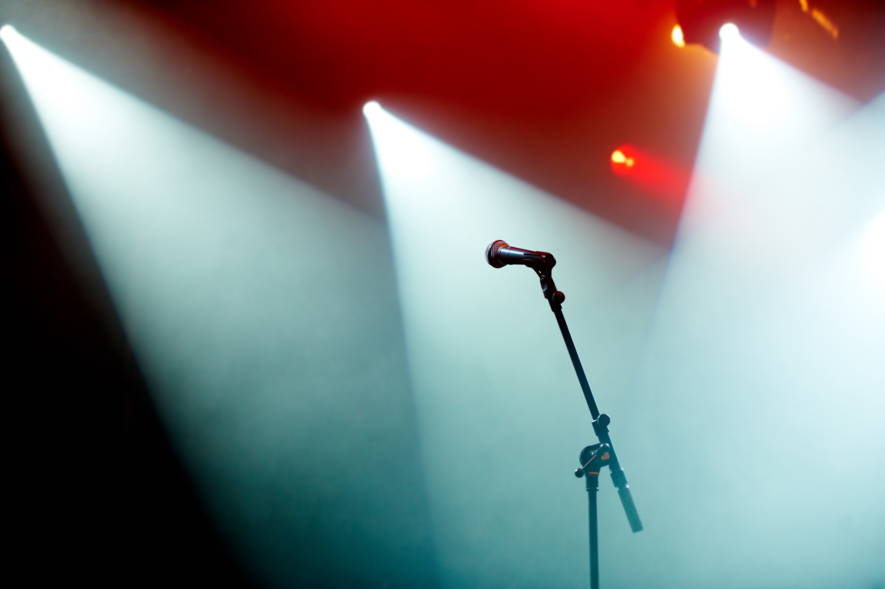
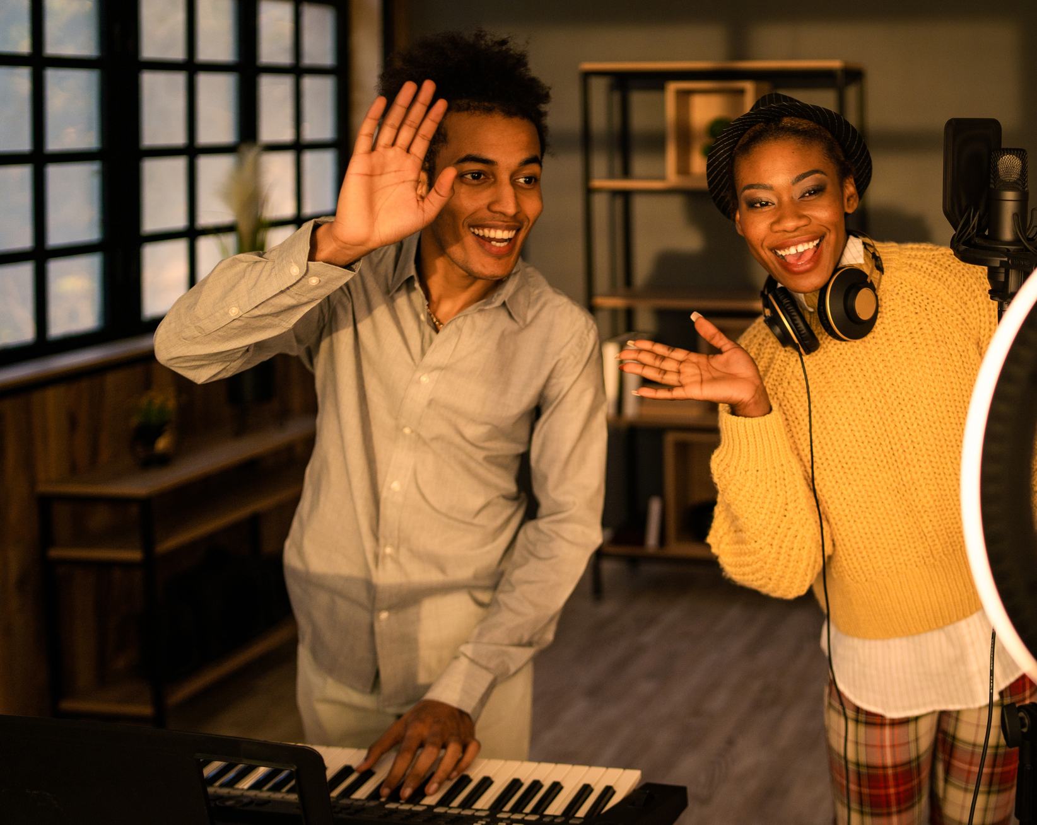
The End of the Show
When the show ends, the lights will come back on.
The audience might clap.
I will walk back to the main entrance.
I will say goodbye to the staff when I leave.
I will travel back to school with my teachers and class.

