Slide 1
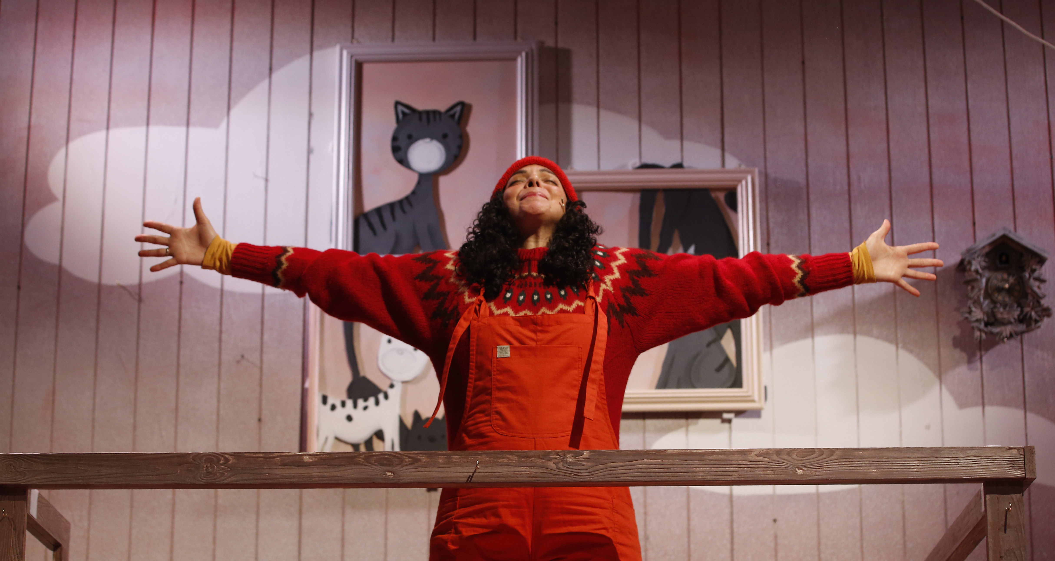
Showtime!
Go & See: Theatre
An opportunity to explore a new environment, engage with world-class theatre, and develop new knowledge and skills.
This pack contains:
A set of resources to use before the show to help you share information with your colleagues, parents/carers and pupils so everyone knows what to expect.
A set of classroom activity ideas to use with your pupils after your show.
Go & See: Schools’ Resources

Slide 2
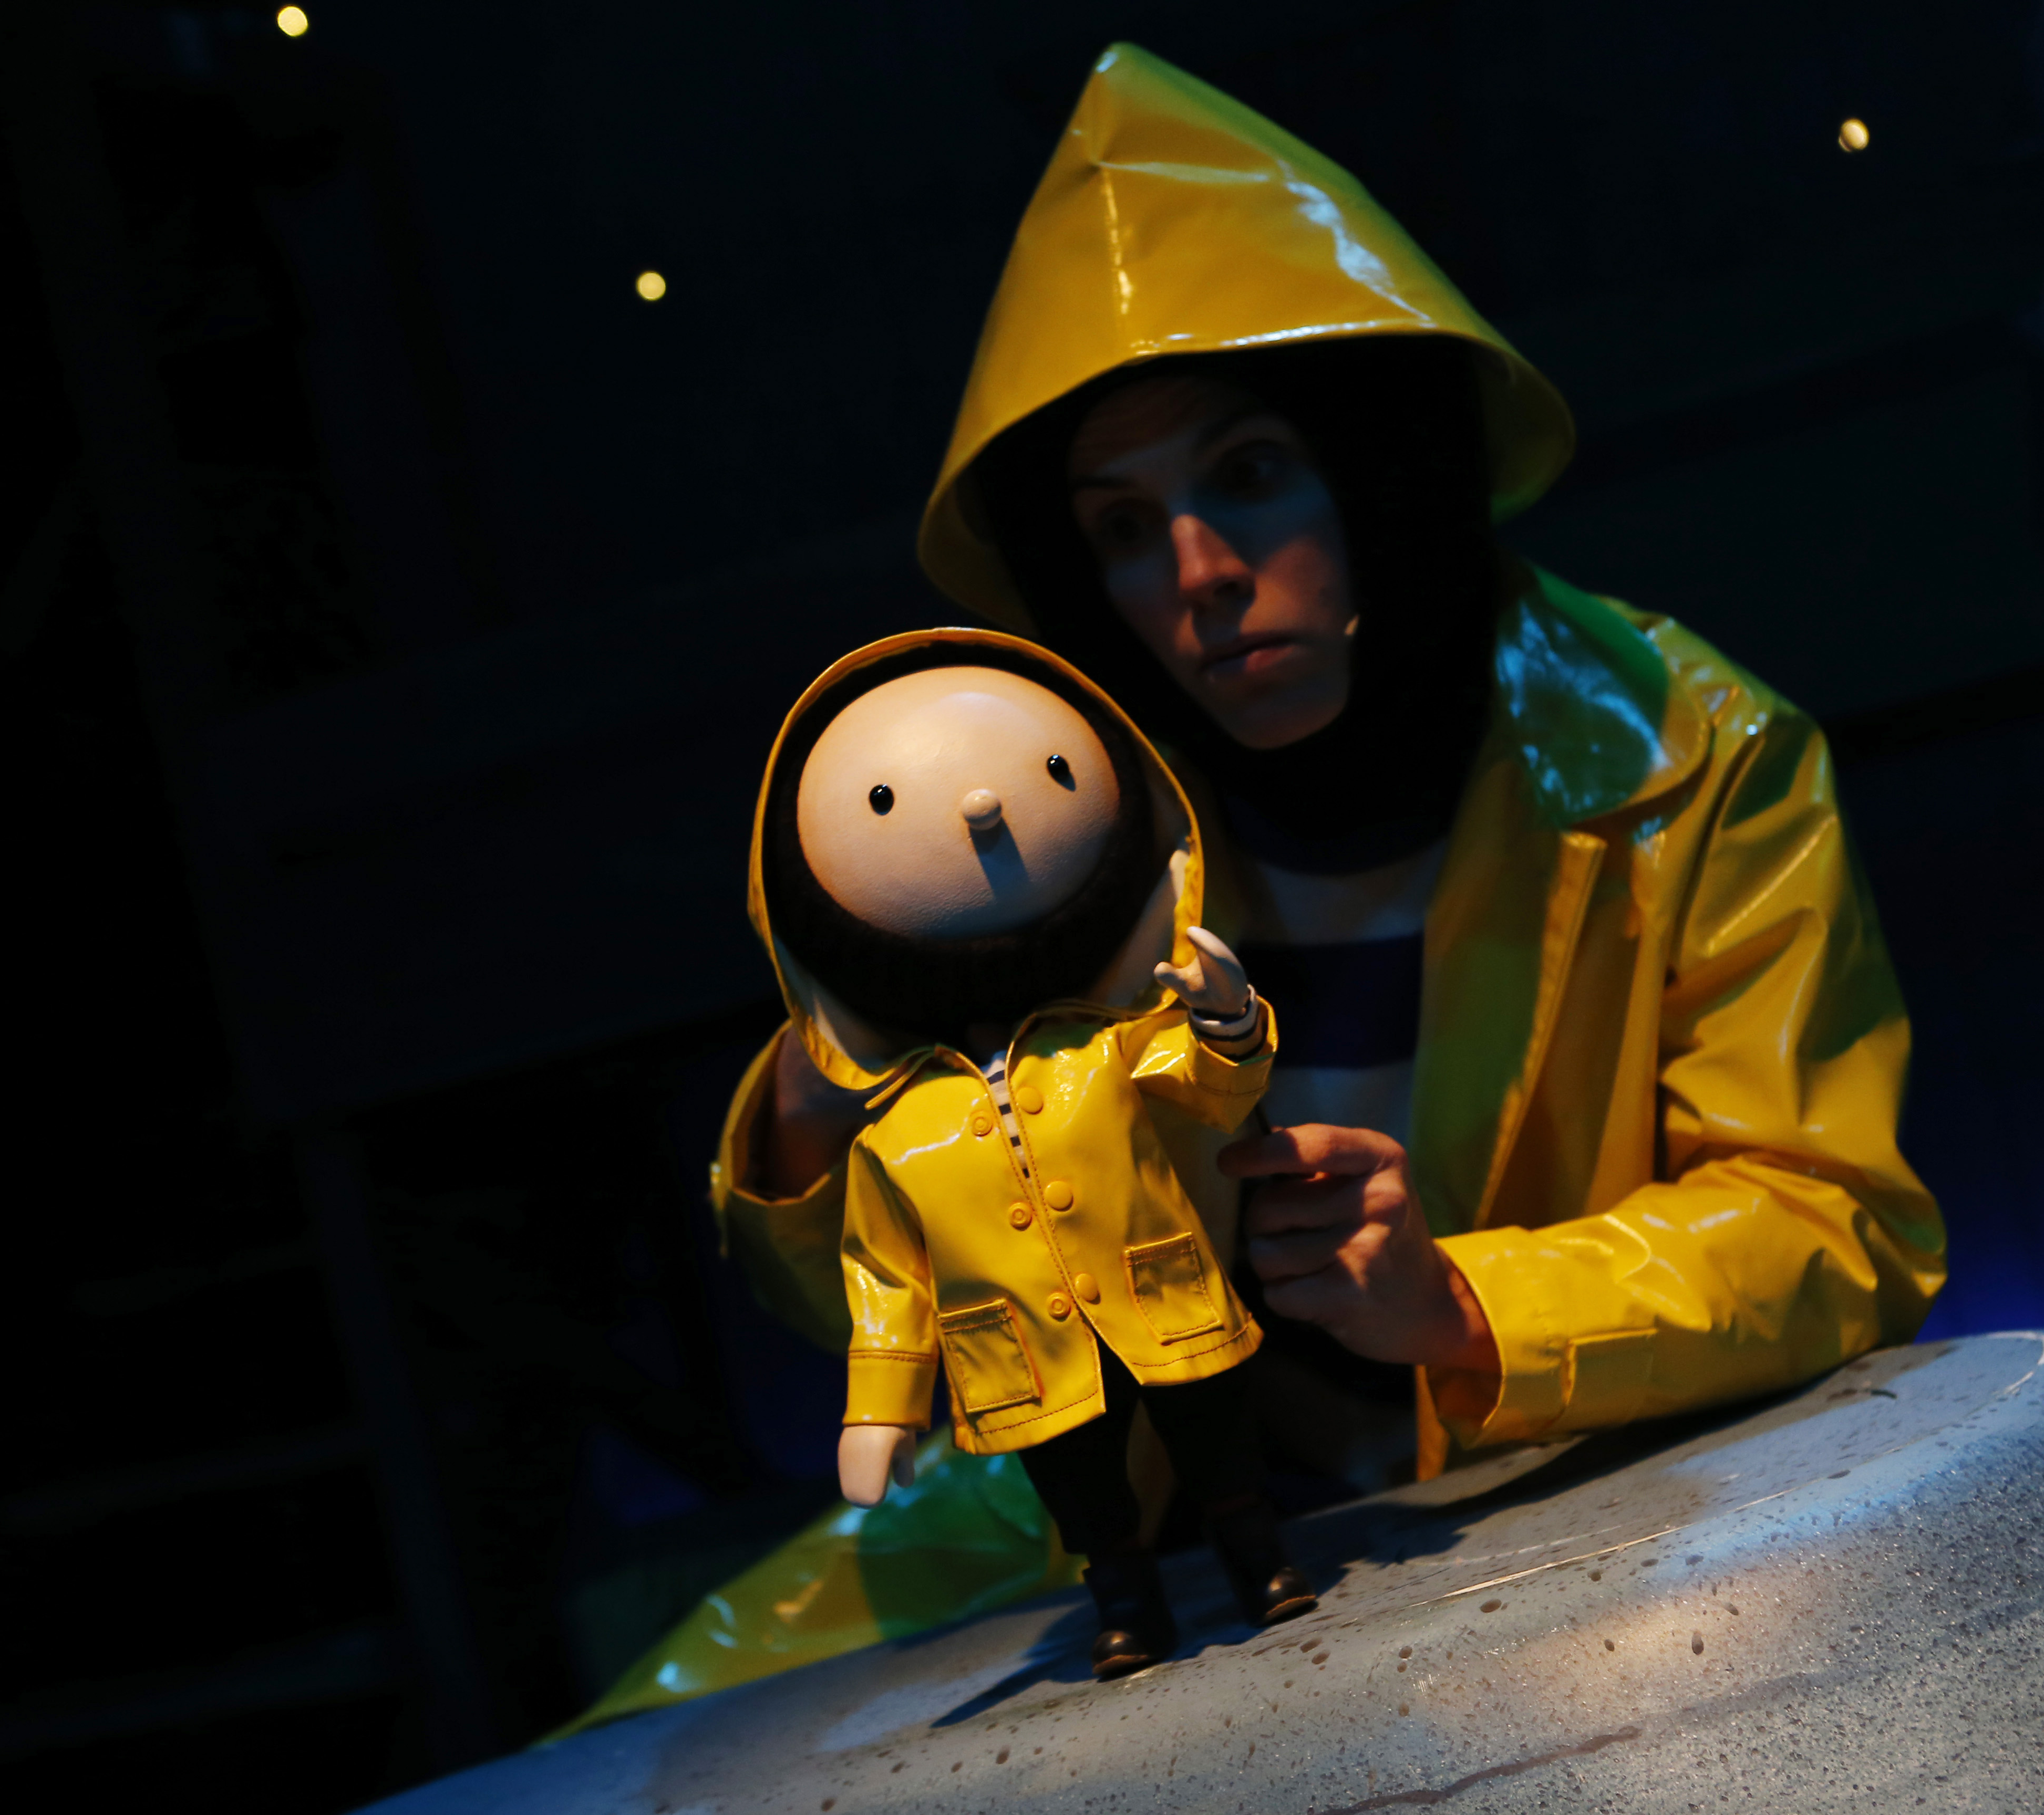
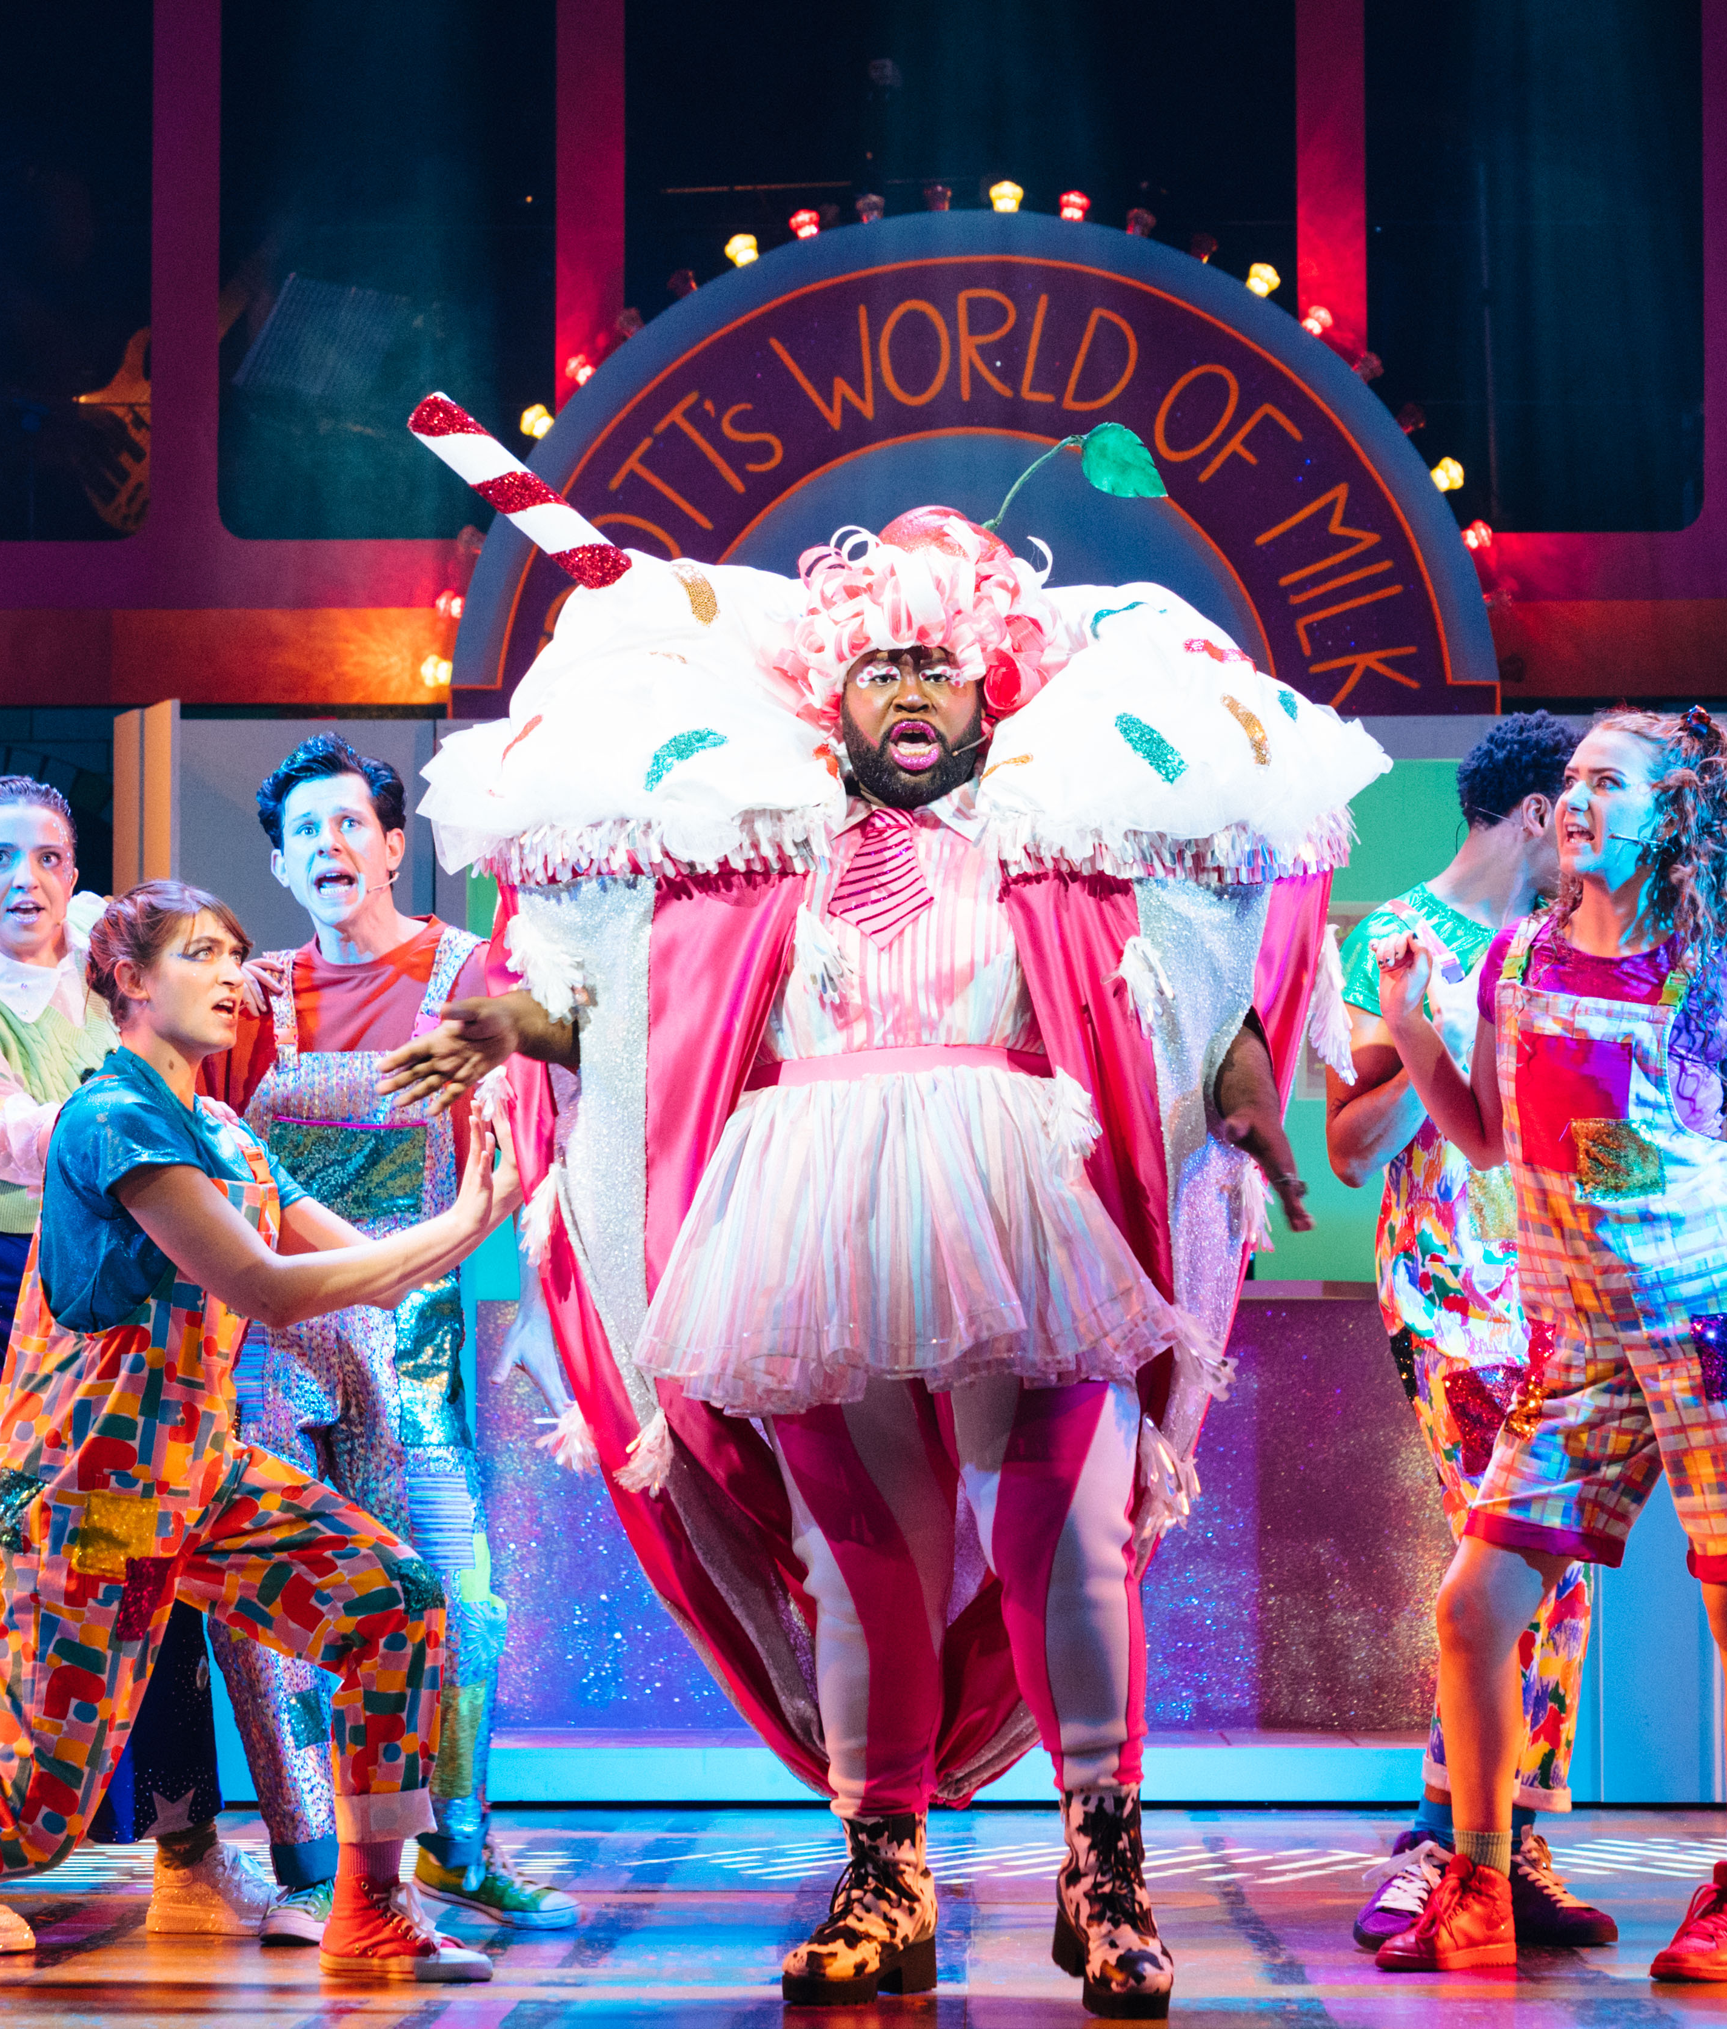
Teacher Notes
Information to share with teaching or support staff before the show.
Before the theatre trip:
Share what is happening and when with your colleagues in school – you could print out and stick up the next page of this resource on your staffroom wall.
Let parents, carers and the wider school community know what is happening – we have provided some wording on the following pages to help. Just add the details then copy and paste.
Prepare your pupils – there are some ideas on how to do this later in the resource pack. We also have a separate Visual Guide resource to support with this.
Let any teaching/support staff who will be present during the trip know what to expect so they can support pupils to access the experience.

Slide 3
Showtime!
Theatre Trip: What you need to know
Our school is taking part in Primary Arts Go & See, a new creative, cultural programme for London primary schools with A New Direction.
We have booked a theatre visit.
Which classes are taking part?
Staff member organising it.
Date and time of the show.
Other members of staff going.
The show we are going to see is:
Where the show is taking place.
Any other useful information:
Duration of the show.

Slide 4
Information to share with parents, carers
and the wider community before the show.
Below is some suggested copy for a letter home to parents/carers or inclusion in your school newsletter:
We are delighted to let you know that our school is taking part in Primary Arts Go & See – a new creative, cultural programme for London primary schools from A New Direction.
The Go & See programme aims to increase access to high quality, inspiring arts, cultural and creative opportunities for students and staff in London’s primary schools.
We have booked a trip to [INSERT VENUE] in [INSERT LOCATION] as an experience for pupils in [INSERT CLASS/ES TAKING PART] on [INSERT DAY AND DATE].
[Choose the relevant paragraph for the show you are going to see on this page or the page that follows.]
Little Angel Theatre Studio: The Storm Whale
Benji Davies’ tender and heart-warming stories of loneliness, love and courage are brought to life in one magical piece of theatre this Christmas. Written and Directed by Matt Aston, The Storm Whale is based on Benji Davies’ award winning books The Storm Whale and The Storm Whale in Winter.
The story follows Noi, who lives with his dad and six cats by the sea. One summer, while his dad was busy at work, Noi rescued a little whale that washed up on the beach. A friendship began that changed their lives forever. The following winter his dad takes one last trip in his fishing boat. Noi is alone once more and longs to see his friend again. Will it take another storm to bring them back together?
Lyric Hammersmith: Jack & The Beanstalk
Join our hero Jack and his trusty cow on an adventure of gigantic proportions, a festive treat for the whole family from the heart of West London.
Following 2024’s magical Aladdin, writer Sonia Jalaly and Nicholai La Barrie are climbing back on board to bring the classic Lyric twist to this epic fairy tale. Expect beanstalk-sized chaos, side-splitting comedy, chart-topping tunes and much more.

Slide 5

Polka Theatre: The Firework Maker’s Daughter
About the show Lila dreams of becoming a Master Firework-Maker just like her father, but to become one she must go on an epic journey that will push her to her limits. Only then can she discover the closely guarded secret to becoming a true firework master.
Time is beginning to run out. When her father’s life depends on her winning the firework competition and pulling off the best display the world has ever seen, can Lila’s skills save the day and light up the skies?
Join Lila on the quest of a lifetime as she faces friend and foe on her illuminating, adventurous journey of self-discovery.
Unicorn Theatre: How Does Santa Go Down
the Chimney?
Ever wondered how Santa goes down the chimney? Feet first? Head first? Or on a zip wire? What if he gets stuck, or there’s no chimney at all? Could he post himself in a parcel or step out of a Christmas movie on TV?
Join us for a thrilling fusion of physical comedy, live music and anarchic fun. Inspired by Mac Barnett and Jon Klassen’s irresistibly funny picture book, this lively engaging performance is the perfect festive treat for pupils of all abilities to wrap up the year.
Theatre Royal Stratford East: Mama Goose
Join local lass Mama Goose and her magical golden egg-laying goose in Stratford this holiday season!
Will Mama Goose be able to resist the temptations of fame and fortune, or will she learn that the best things in life are free?

Slide 6
Information to share with pupils before the show.
Before the show, play each class the trailer of the production you are going to see (where available). You will find links to the trailers, as well as access information and extra resources on A New Direction’s website.
You might like to talk through the following prompts to be ready for the performance.
What is a theatre and what makes it special?
What makes a good performance?
What makes a good audience?
Following this discussion, you might want to make your own list of ‘being a good audience’ before checking it against some of these:
Be safe:
• Listen to and follow instructions from the theatre staff.
• Use the toilet before you go in to watch the show.
• Don’t eat while the show is happening
• Tell your teacher or other trusted adult if you need a break.
Respect other people:
Stay sitting down so everyone can see and hear.
Respect everyone’s personal space – don’t kick someone’s chair, wriggle or put your feet on the seats.
Don’t talk when the show is on unless the actors ask you to take part.
Say thank you:
• At the theatre we show our thanks by clapping. It’s important to clap the performers and also the crew, musicians, and everyone who helped make the performance possible.
• We also say thank you to the theatre staff for their help and assistance.
You can also let your pupils know what to expect using the discussion prompts on the next page.

Slide 7
Thinking about our theatre trip
Who do you think the main characters in the show will be?
How do you think you should behave when you are at the theatre?
What props do you think you might see on stage?
How can we make sure that we all enjoy the show? For example, we will need to sit quietly in our seat.
What kind of music, songs or sounds do you think the show will include?
In parts of the show, they might ask us to take part – what do you think they might ask us to do?
How do you feel about going to the theatre? Are you excited, nervous, happy?
What do we do at the end of the show to say thank you?

Slide 8
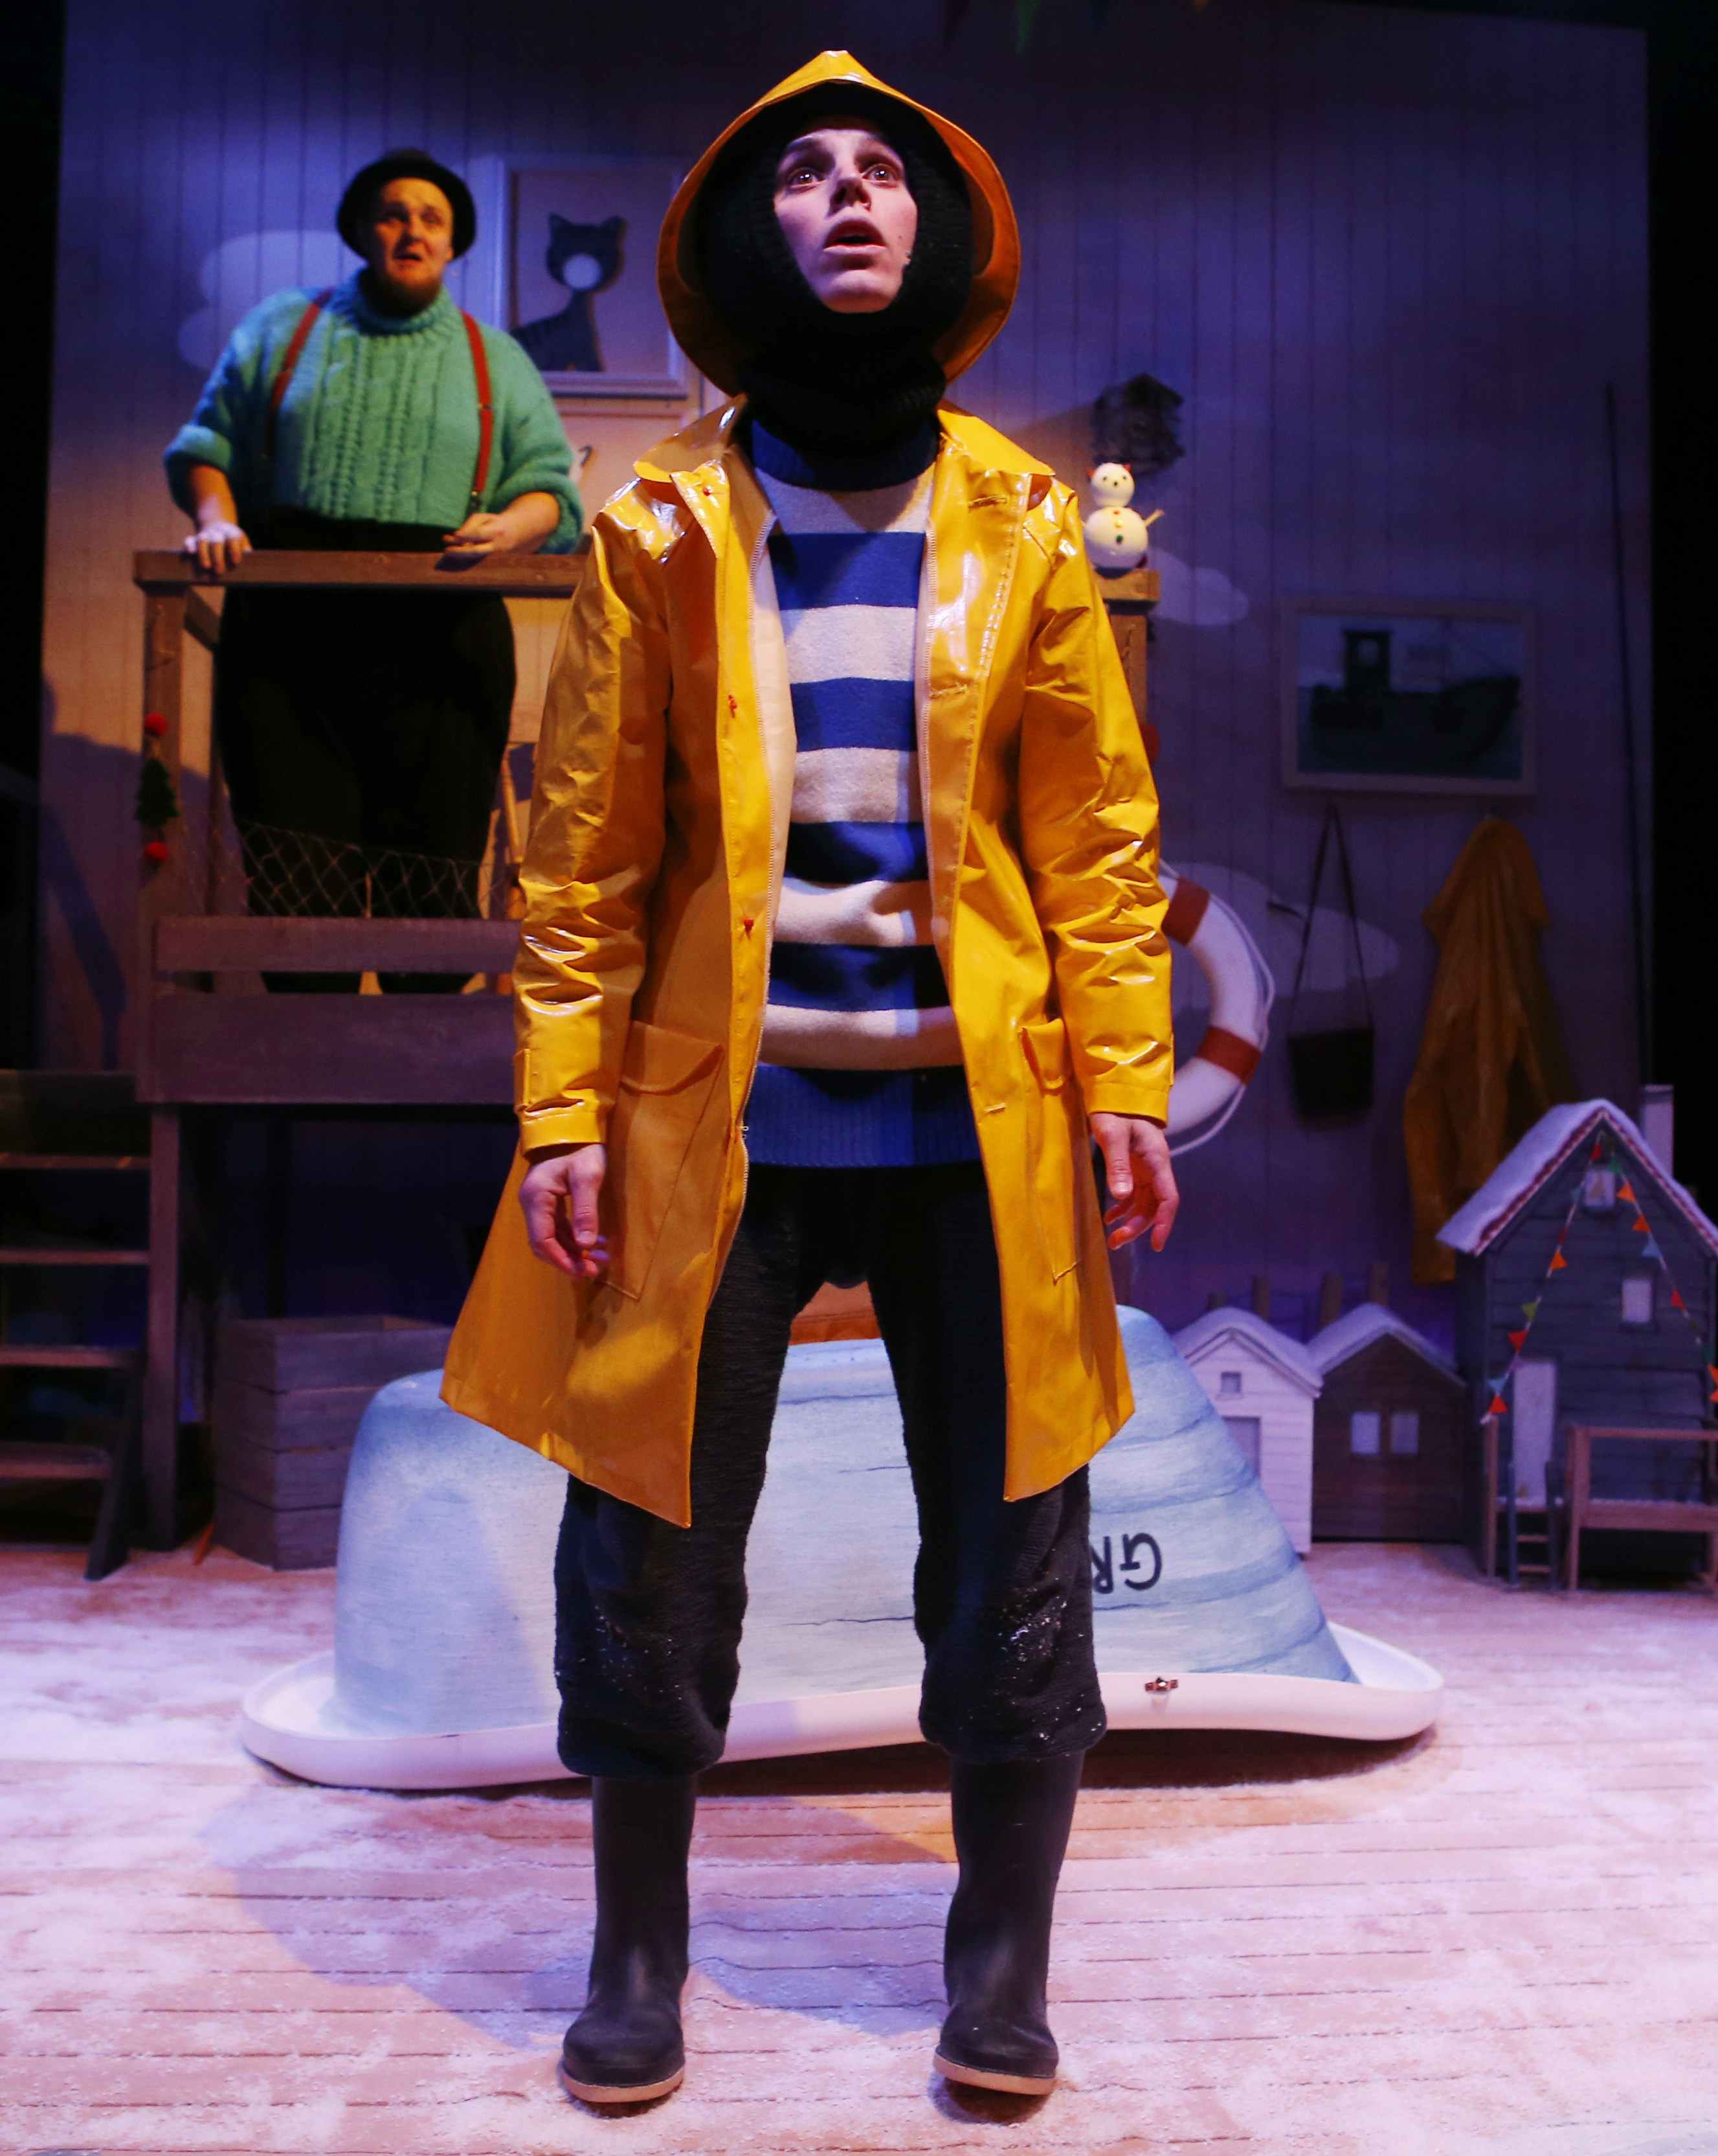

Take a bow!
Post-Show Resources
We hope that your school enjoyed the show!
Exploring the themes of the show and supporting pupils to reflect on the experience, we have suggestions for 10 minutes, 30 minutes or a full 1-hour lesson.

Slide 9
If you have 10 minutes
Box Office Vox Pop
Ask pupils to interview each other in pairs for a couple of minutes each, then as a whole class write up some short sentences to share in your school newsletter or assembly.
You have just come out of the theatre and a journalist grabs your attention to ask you what you think as you are leaving. Journalists: use a pen/ruler/your hand as a microphone and ask your talk partner:
• How are you feeling?
• What was the show you just saw?
• What was your favourite part?
• Can you sum up the performance in just one word?
Challenge students to think of their own questions and follow up questions to what’s been said.
Go Further: Pupils could write up a review of the experience or perform a memorable part in groups.
SEND: Focus on two of the questions and provide sentence frames, word mats with key vocabulary and pictures from the show to scaffold students as needed.
Creative Skills: In this activity pupils are collaborating by co-operating together and sharing reflections.

Slide 10
If you have 30 minutes
Invite others to see the show!
Do the discussion activity above to reflect on the show, then support pupils to think of something you could send or share with other pupils who haven’t yet experienced the performance.
Children at other schools are going to see the same show we saw. Let’s send them an invitation… how could we make them excited to see the show? What do we want to tell them and how can we do this in a creative way? What should we keep as a surprise? Why?
Allow pupils to think of ideas in groups and then present back to the class – they could perform, write up or draw their ideas.
Reflection: How does your invitation link to the show? What else does it make you think of?
Go Further: Pupils could make the actual invitations in DT/Art/Literacy lessons and then display them in the classroom/school hall/display boards.
SEND: Focus on thinking of an object and a word to send to other pupils that links to the show. Provide options and key words for pupils to choose from.
Creative skills: In this activity pupils are collaborating and being imaginative by playing with possibilities.

Slide 11
If you have 1 hour
Bring the play to life with a performance of 'talking tableaux'
​Ask your class to summarise the story (or 'plot') of the play in pairs – each person has one minute to try and summarise it. If anyone is feeling confident, see if they can tell the story in one minute to the whole class. ​
Show your class the 'plot' of the play, breaking it down into around 8 bullet points (depending on the size of your class). Did they remember them all? Which moment was the most exciting? Which moment was their favourite and why? Choose some questions to discuss or write in your exercise book. ​
In groups, bring the play to life as 'talking tableaux' (or talking pictures). Give each group one moment from the play to create as a still image that they will bring to life for one full minute. Before rehearsing their talking image, they should discuss who was in that moment, what was on stage, and the other details of what should happen in their scene. You may wish to list the characters on the board to support them.​
Each group presents their scene in order, bringing the story to life for one minute each. ​
Go Further: 'Freeze' the scene during performance to ask characters how they feel at key moments.​
SEND: Focus on one key moment which they can draw before acting out. Provide a print-out of the plot summary for their book.​
Creative Skills: In this activity pupils are collaborating by co-operating together and being.

